Slide 1
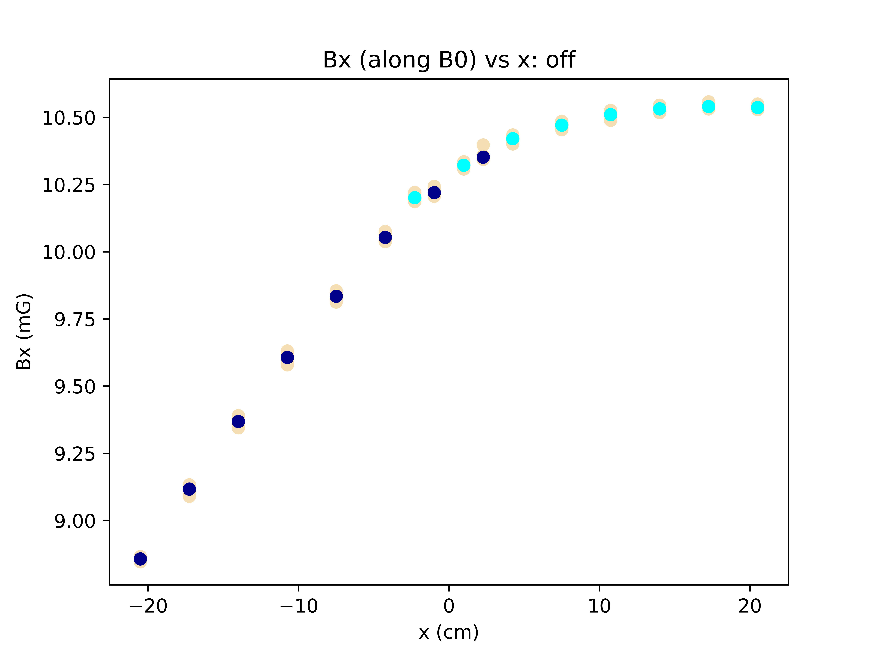
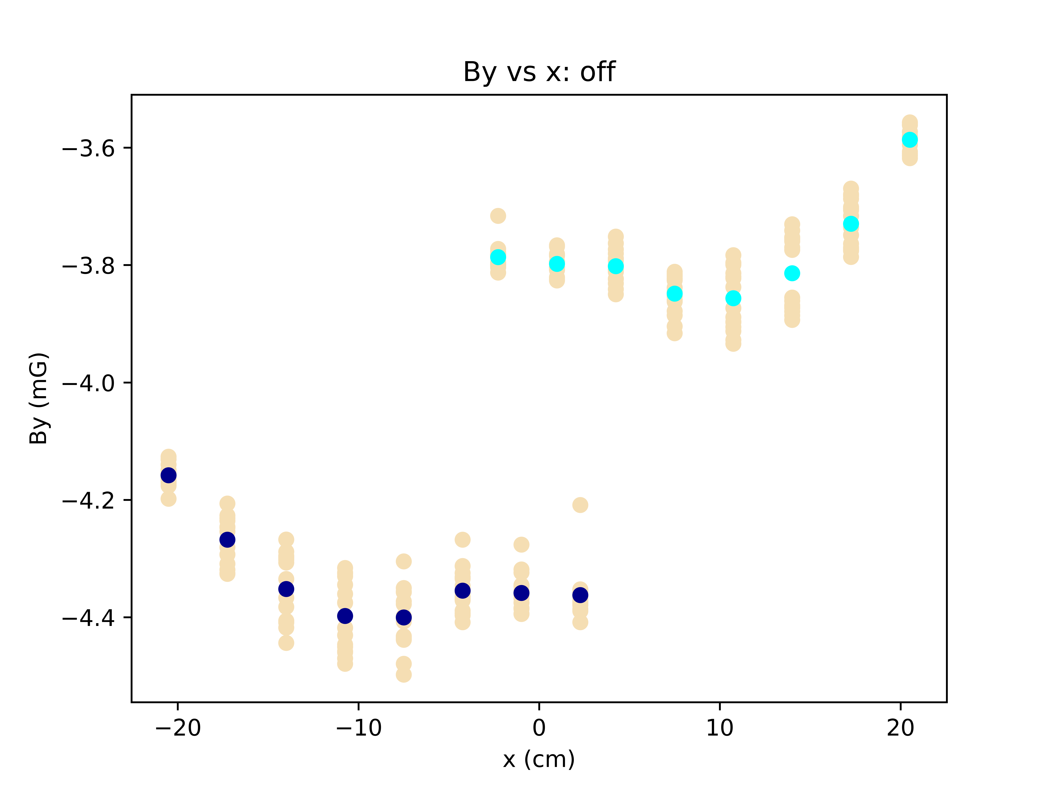
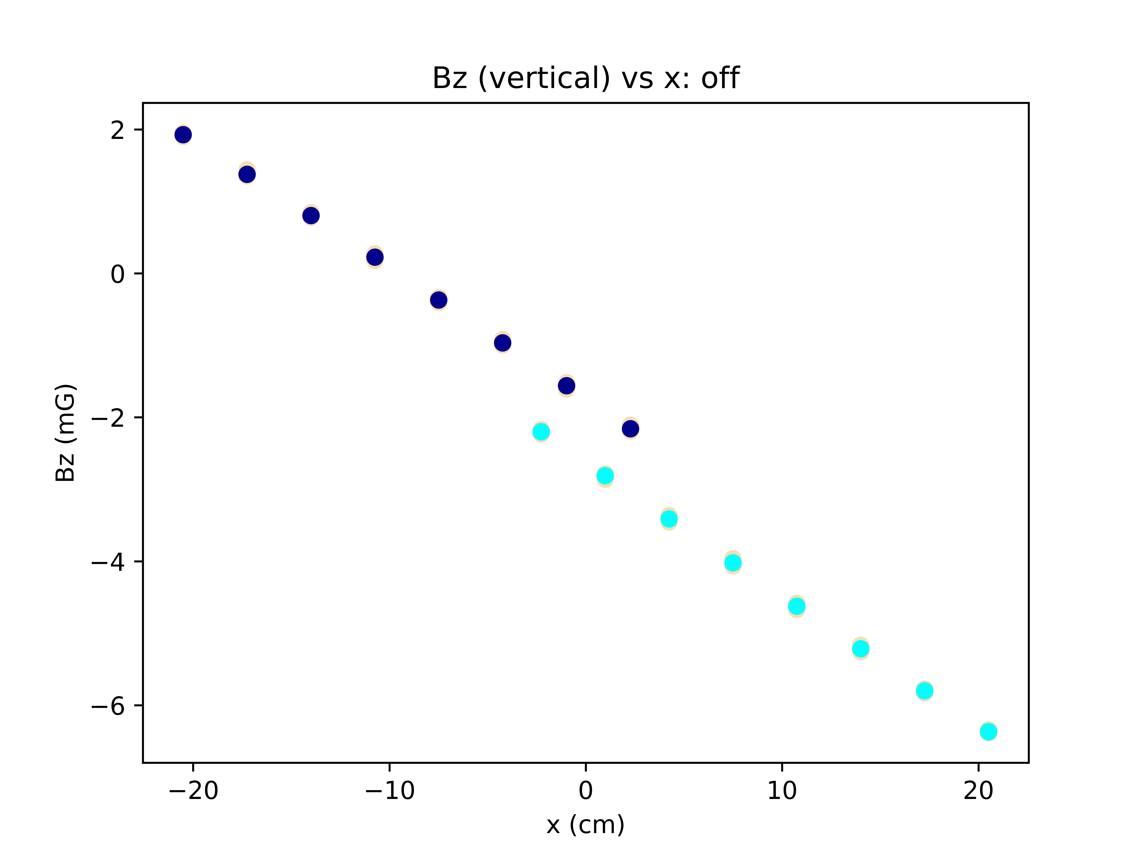
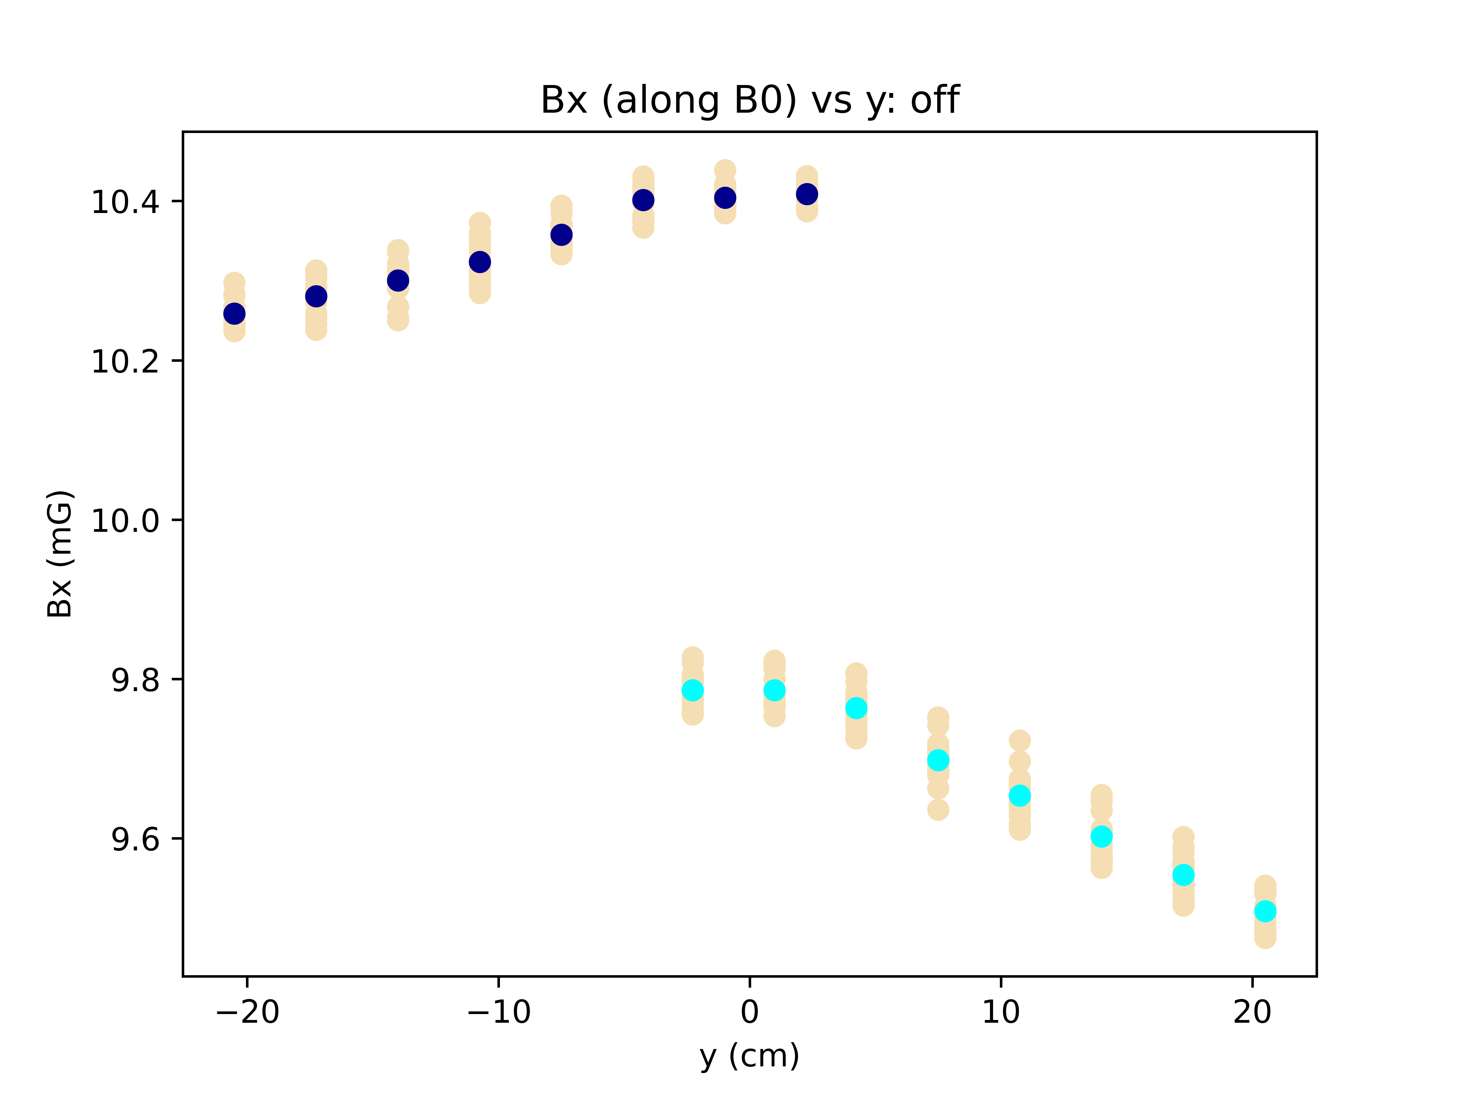
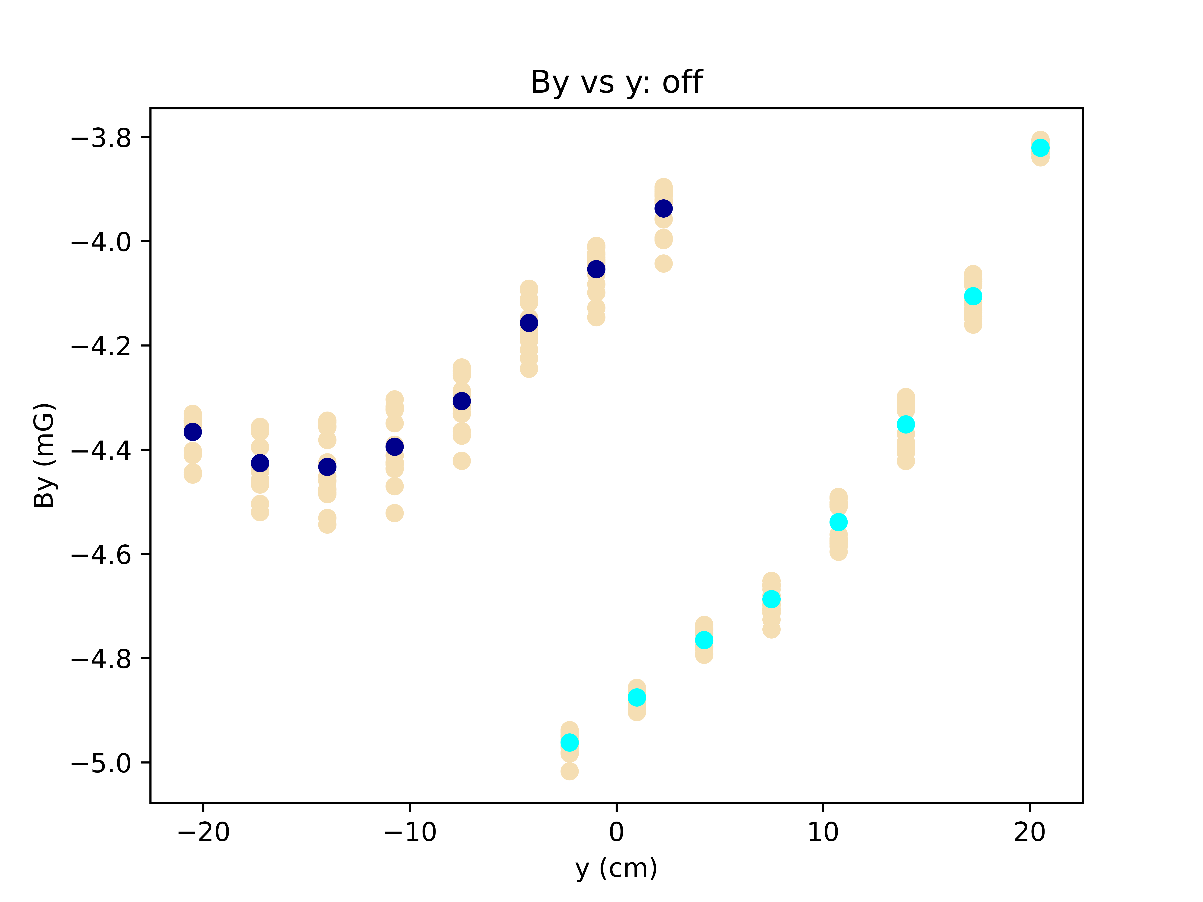
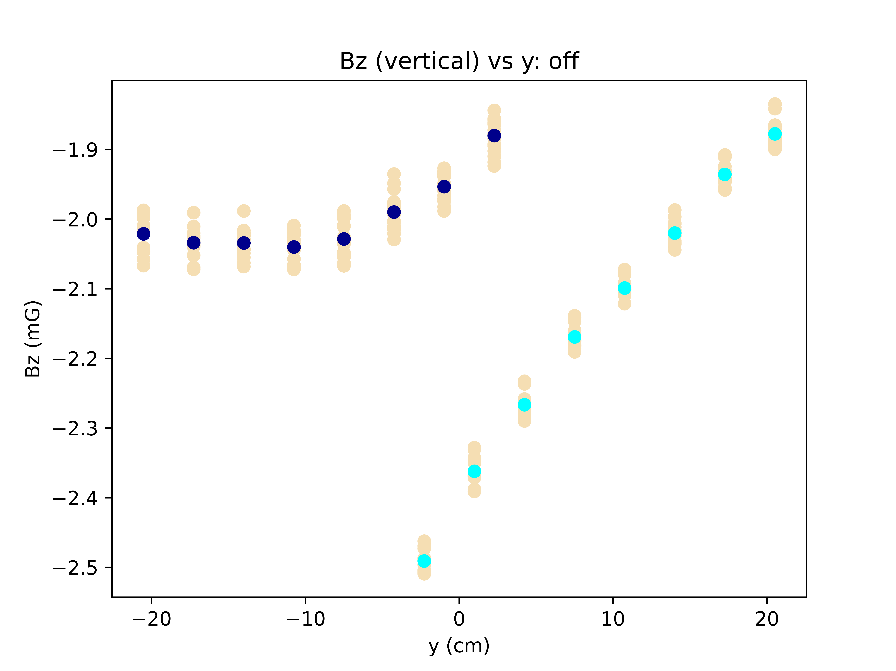
Data from 3/30.
Plots at vertical height V=0cm, at center.
B0 off. No time corrections

Slide 2
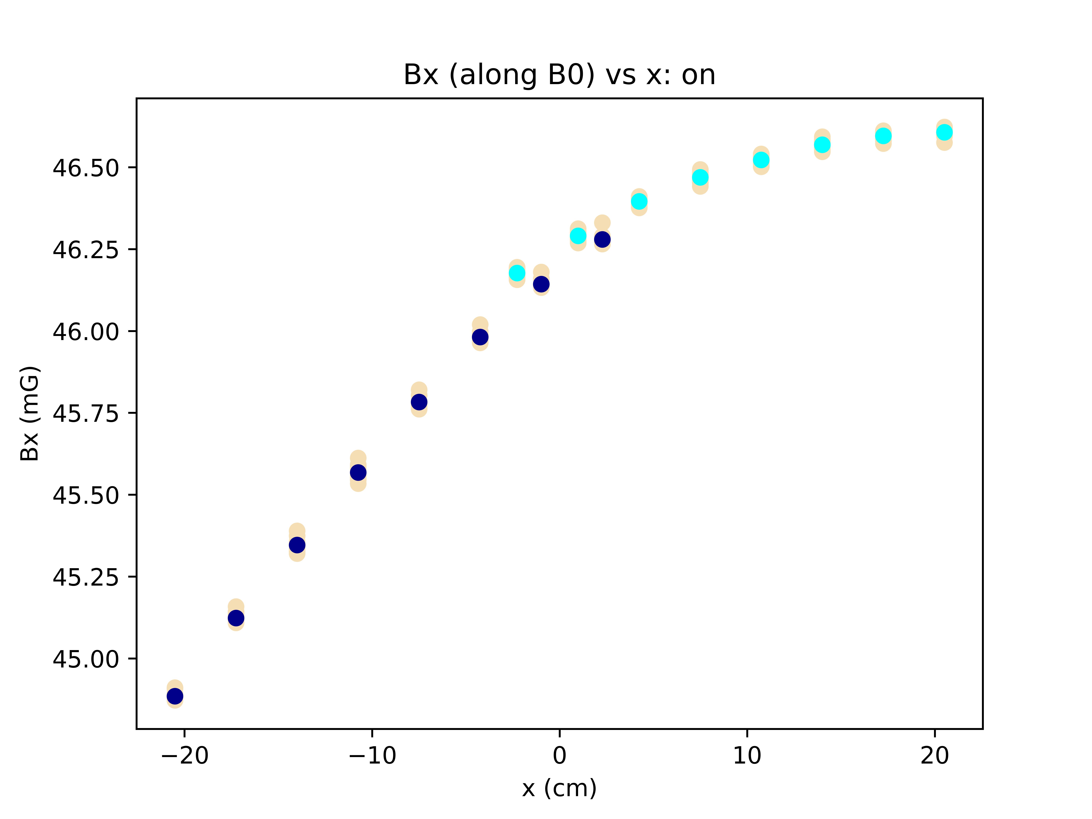
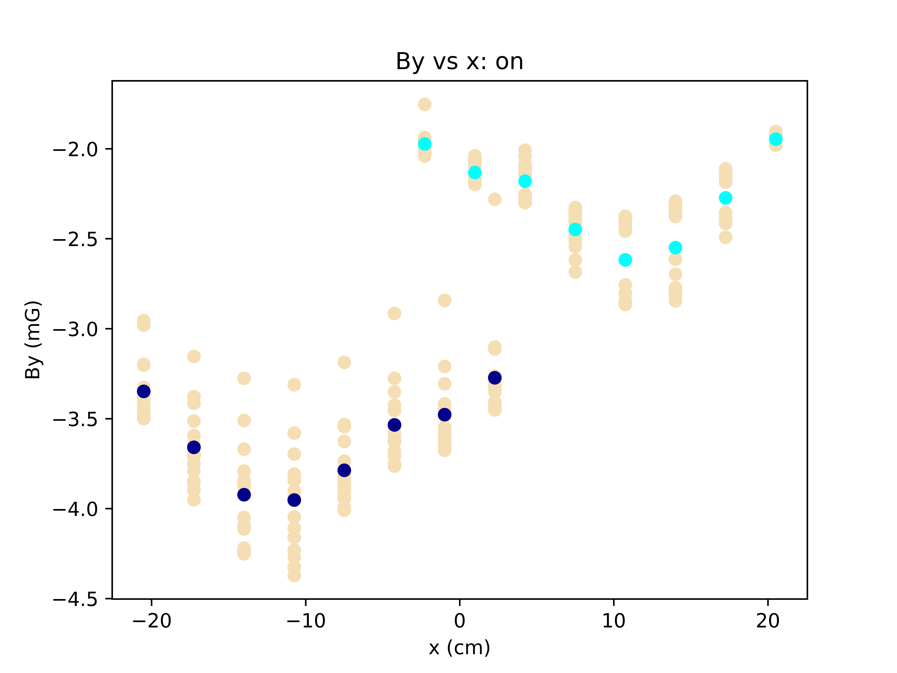

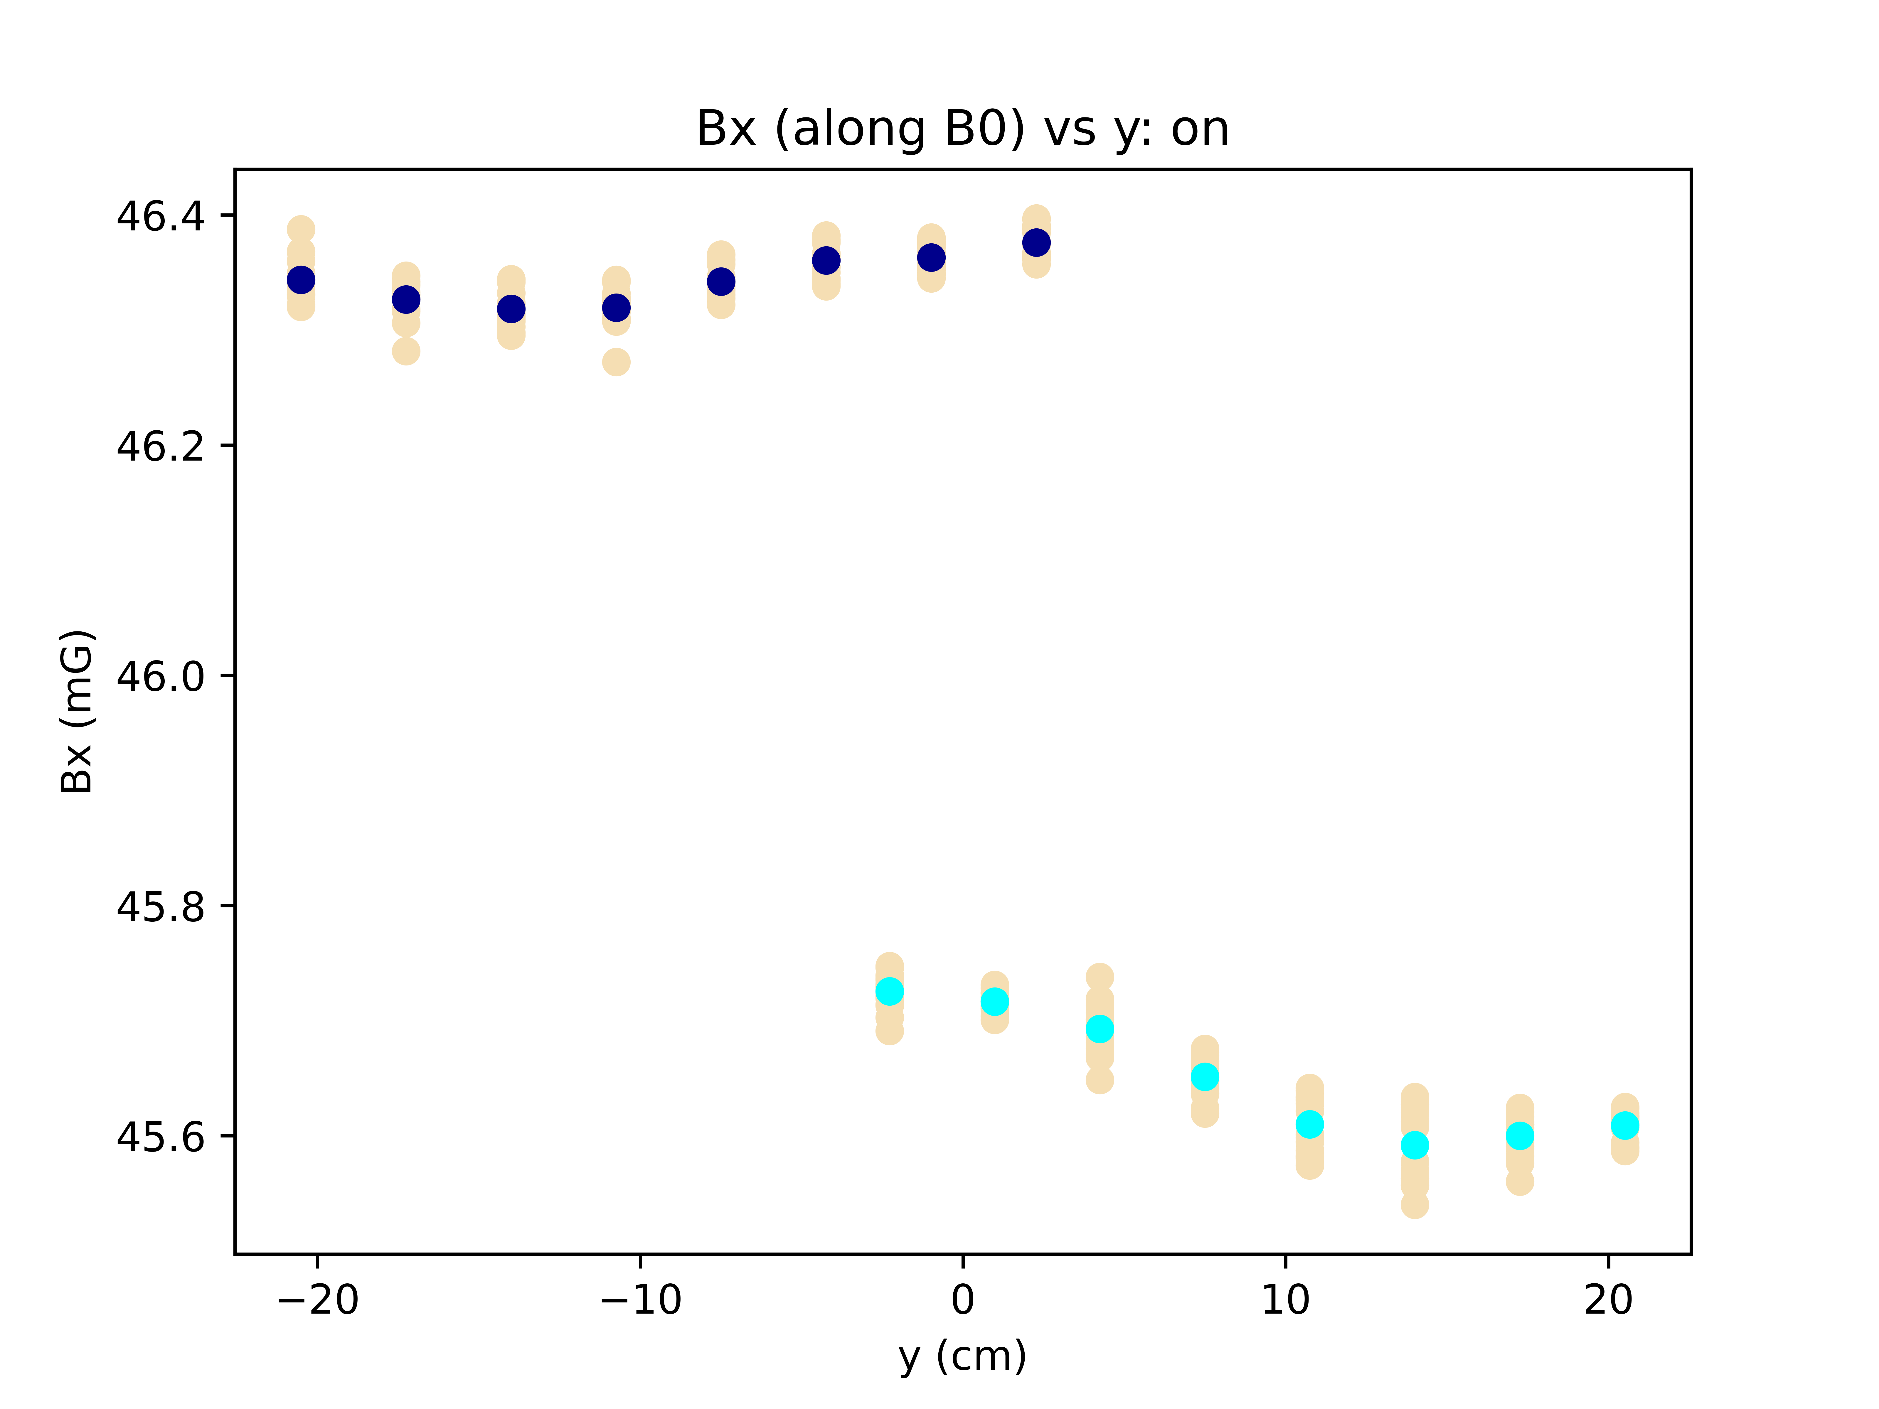
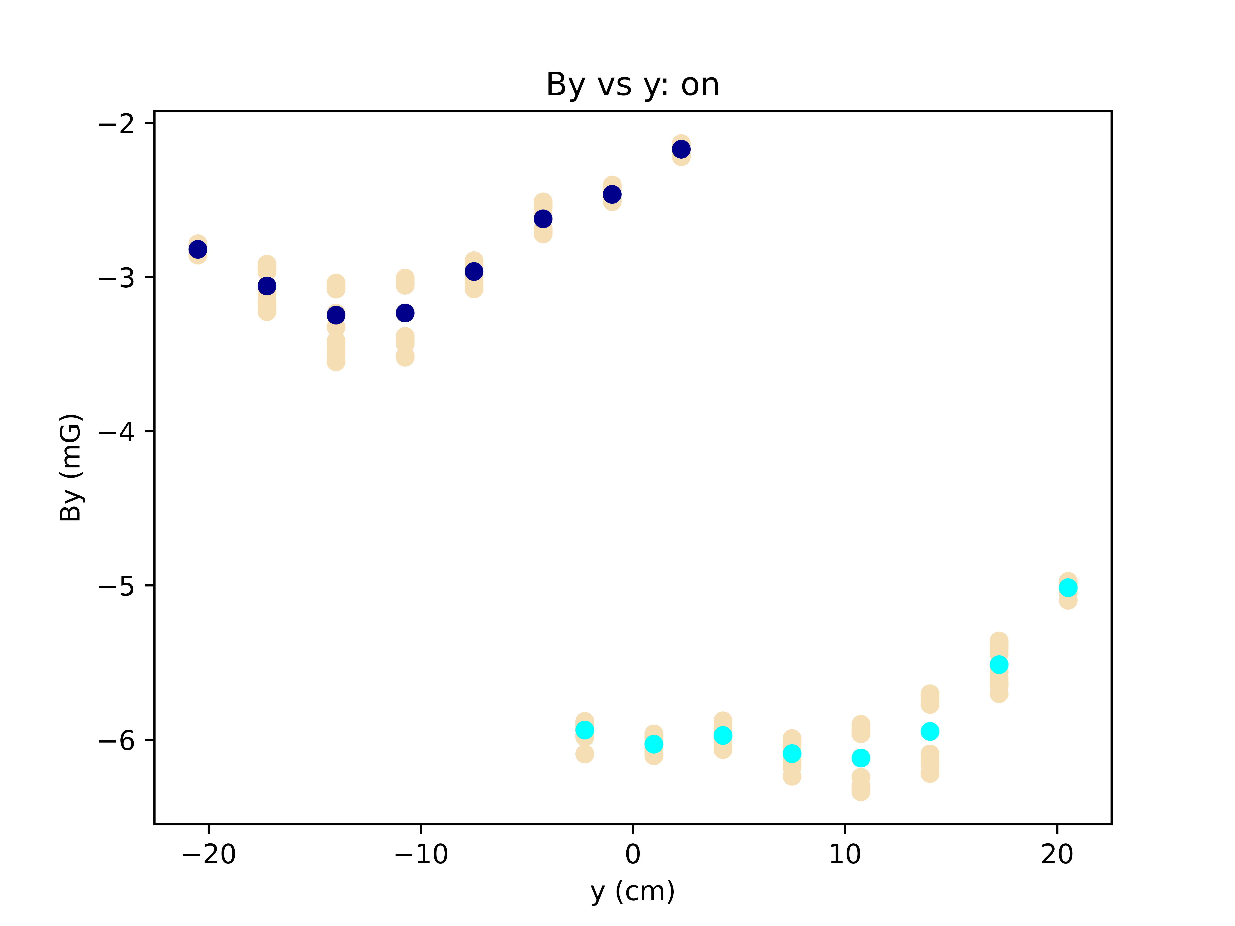
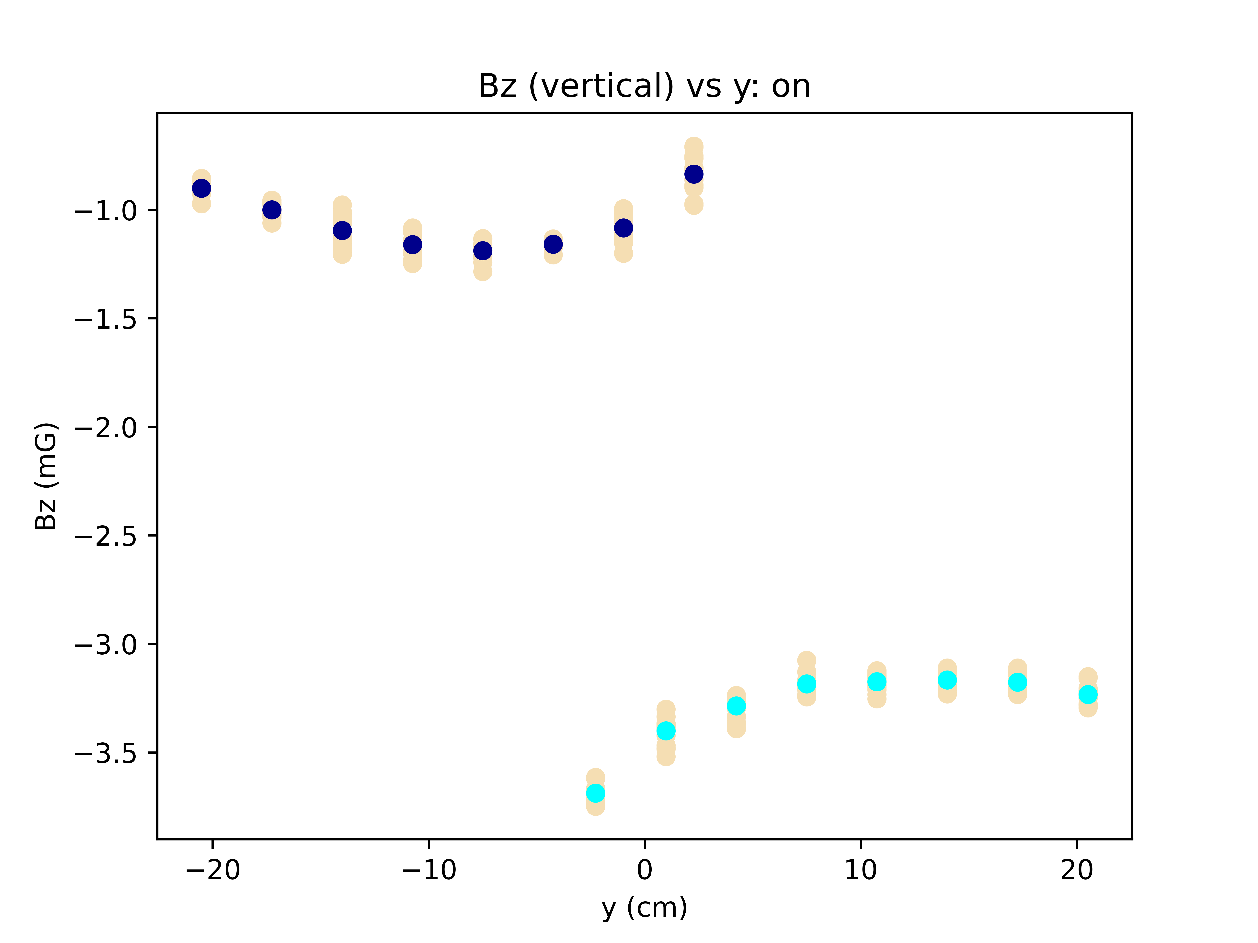
Data from 3/30.
Plots at vertical height V=0cm, at center.
B0 on. No time corrections

Slide 3
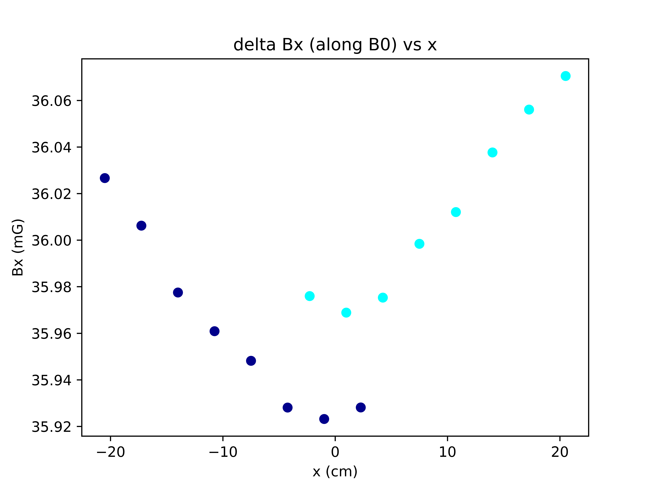
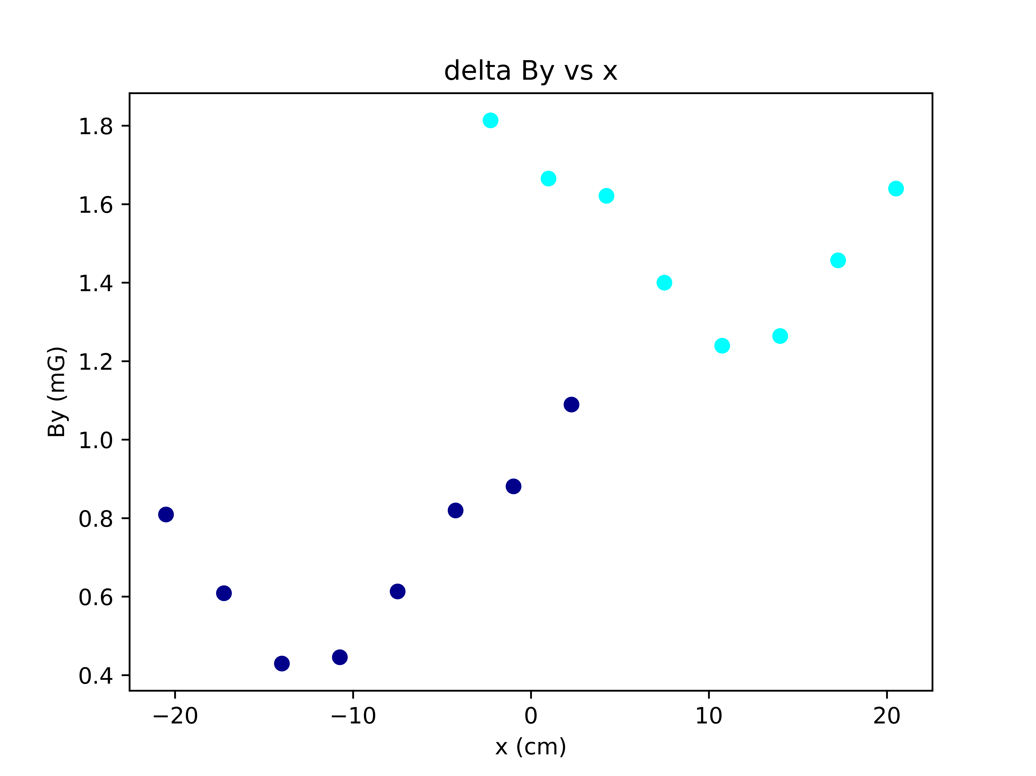
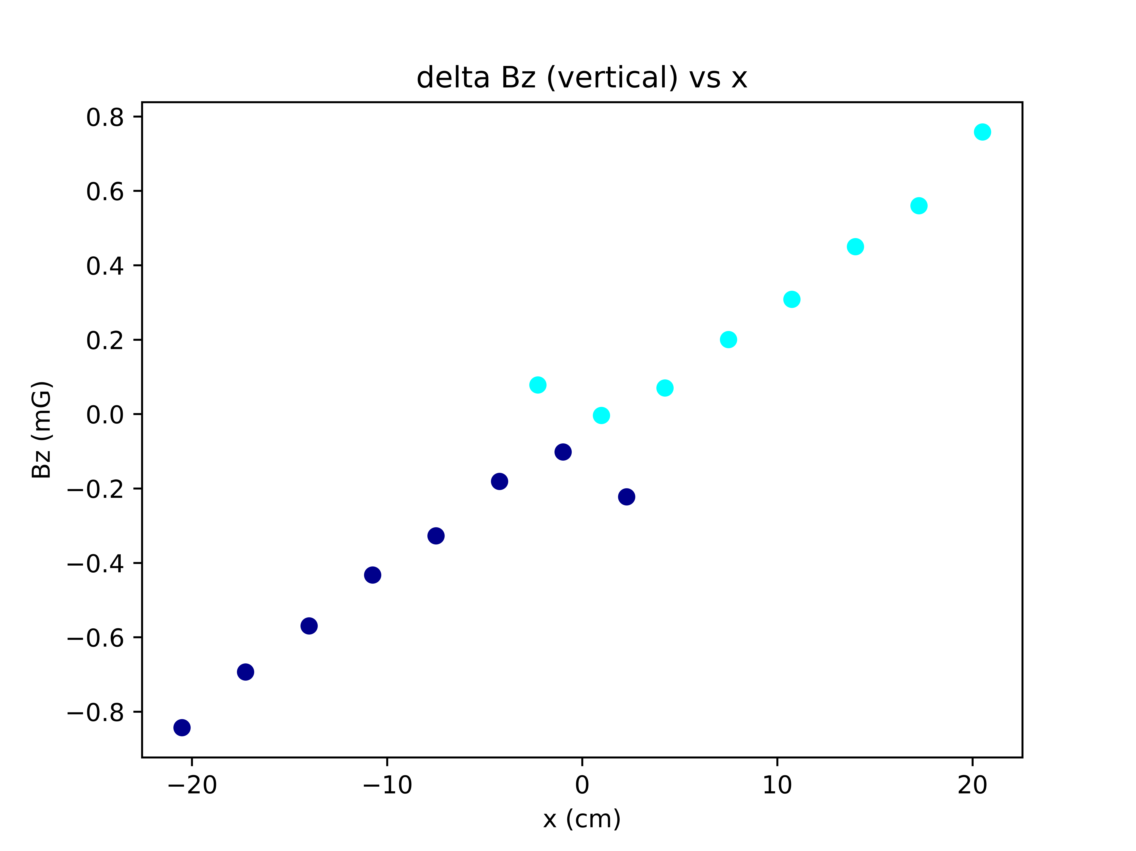
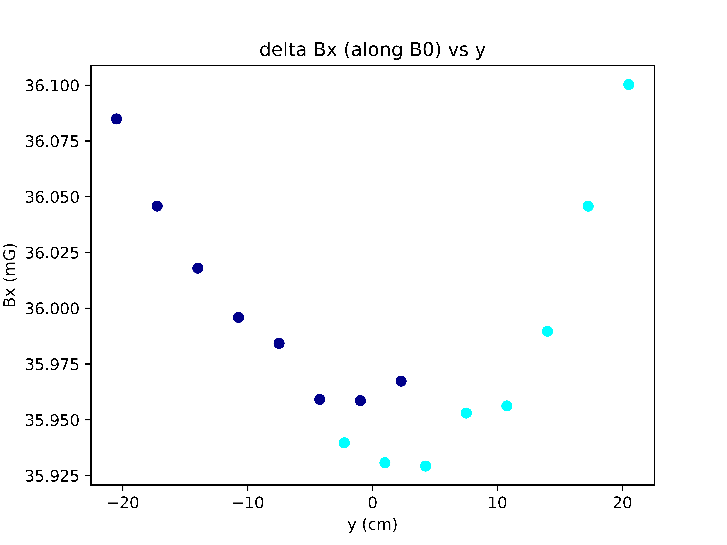
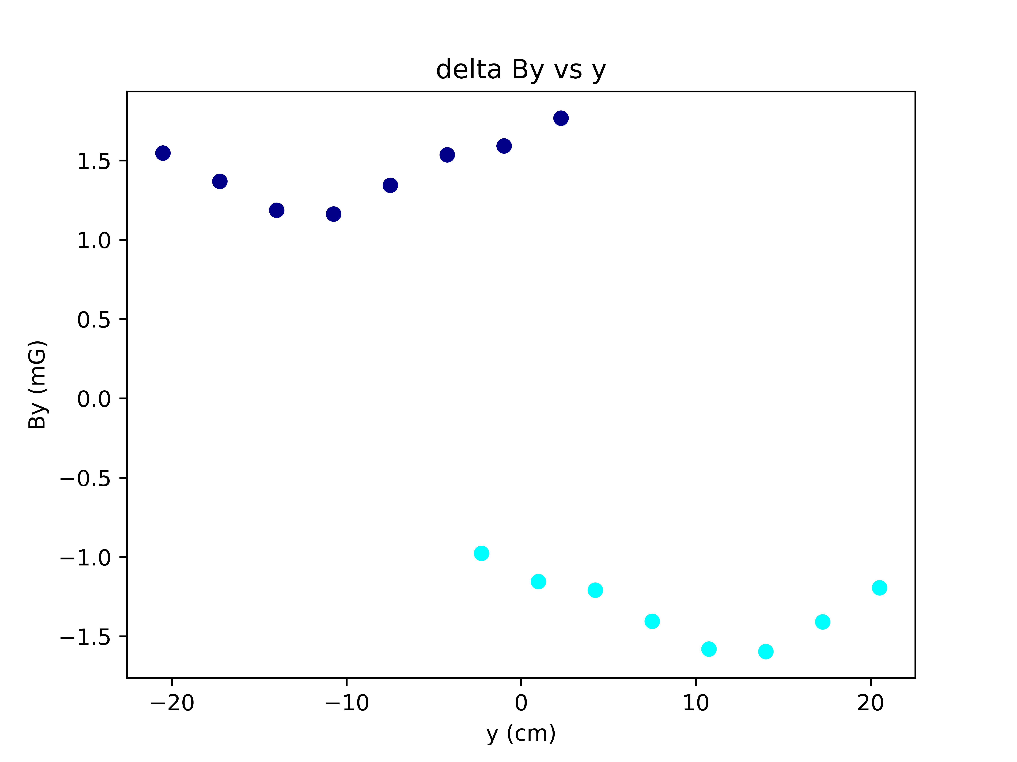
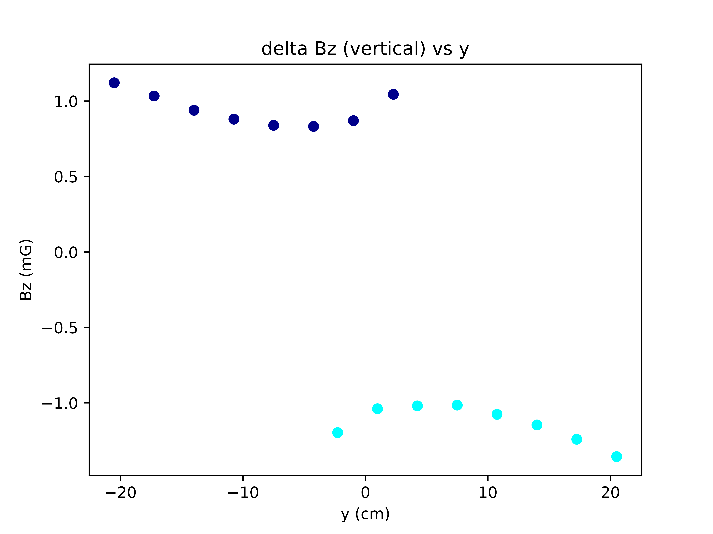
Data from 3/30.
Plots at vertical height V=0cm, at center.
Difference plots. No time corrections

Slide 4
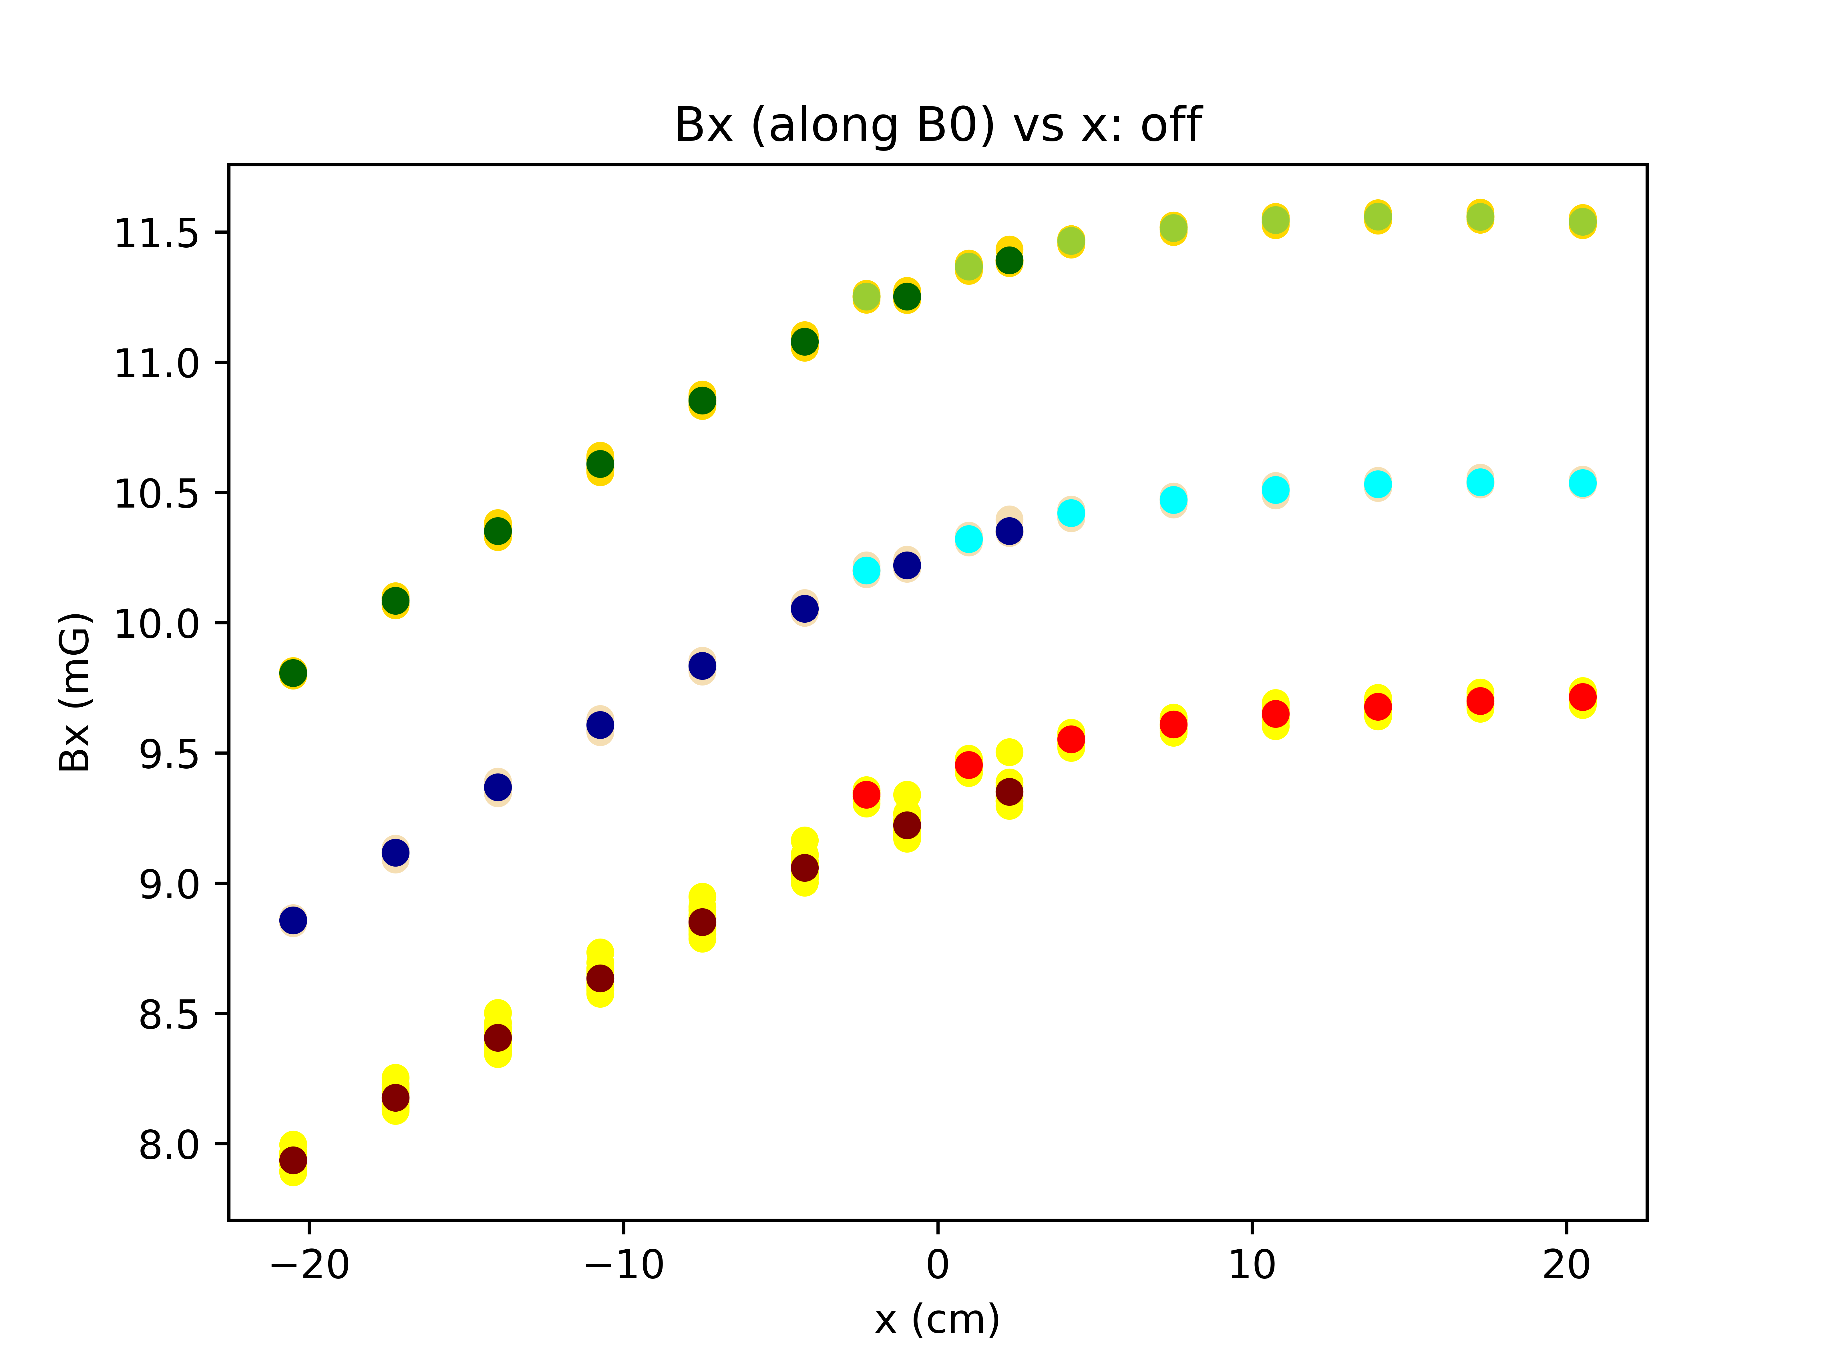
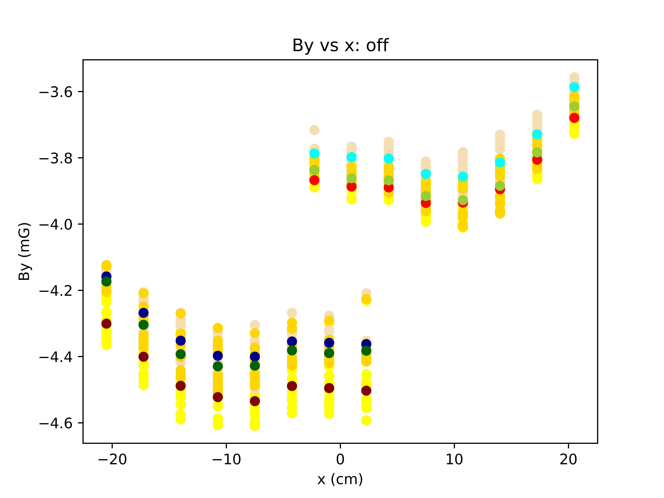
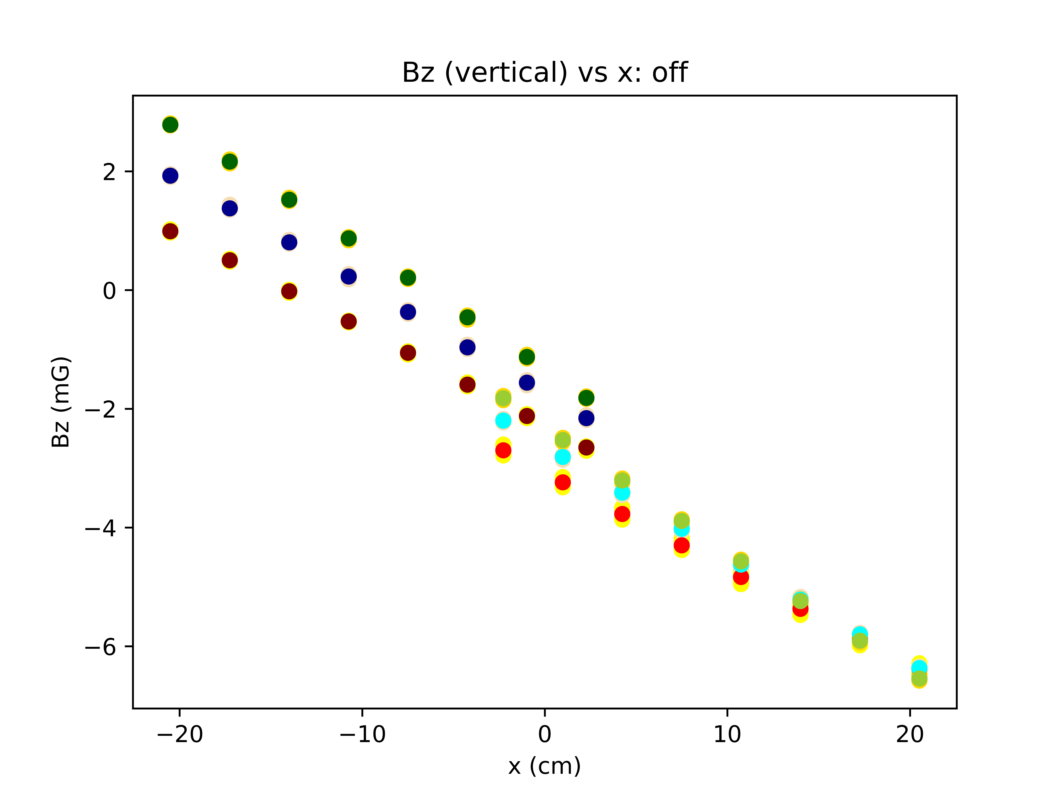
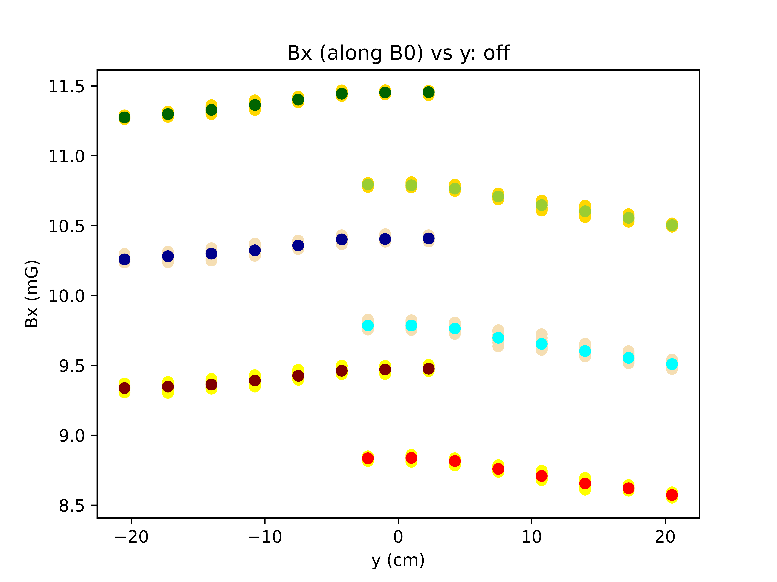
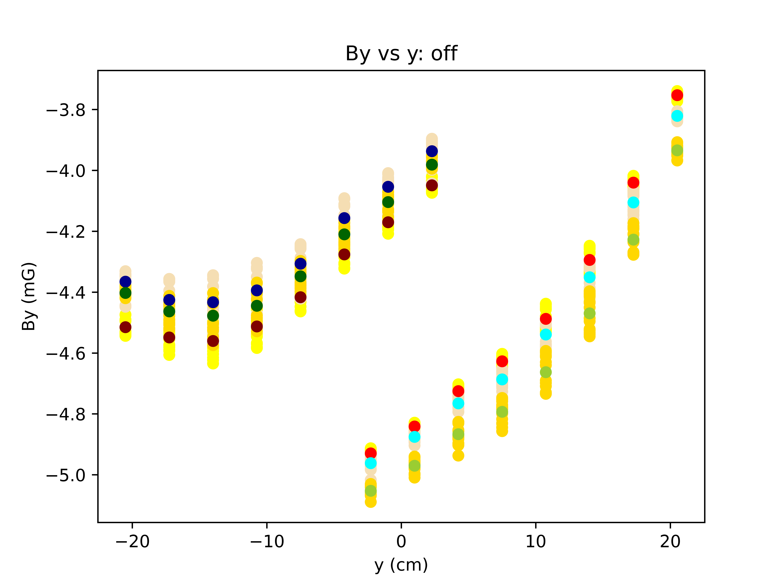
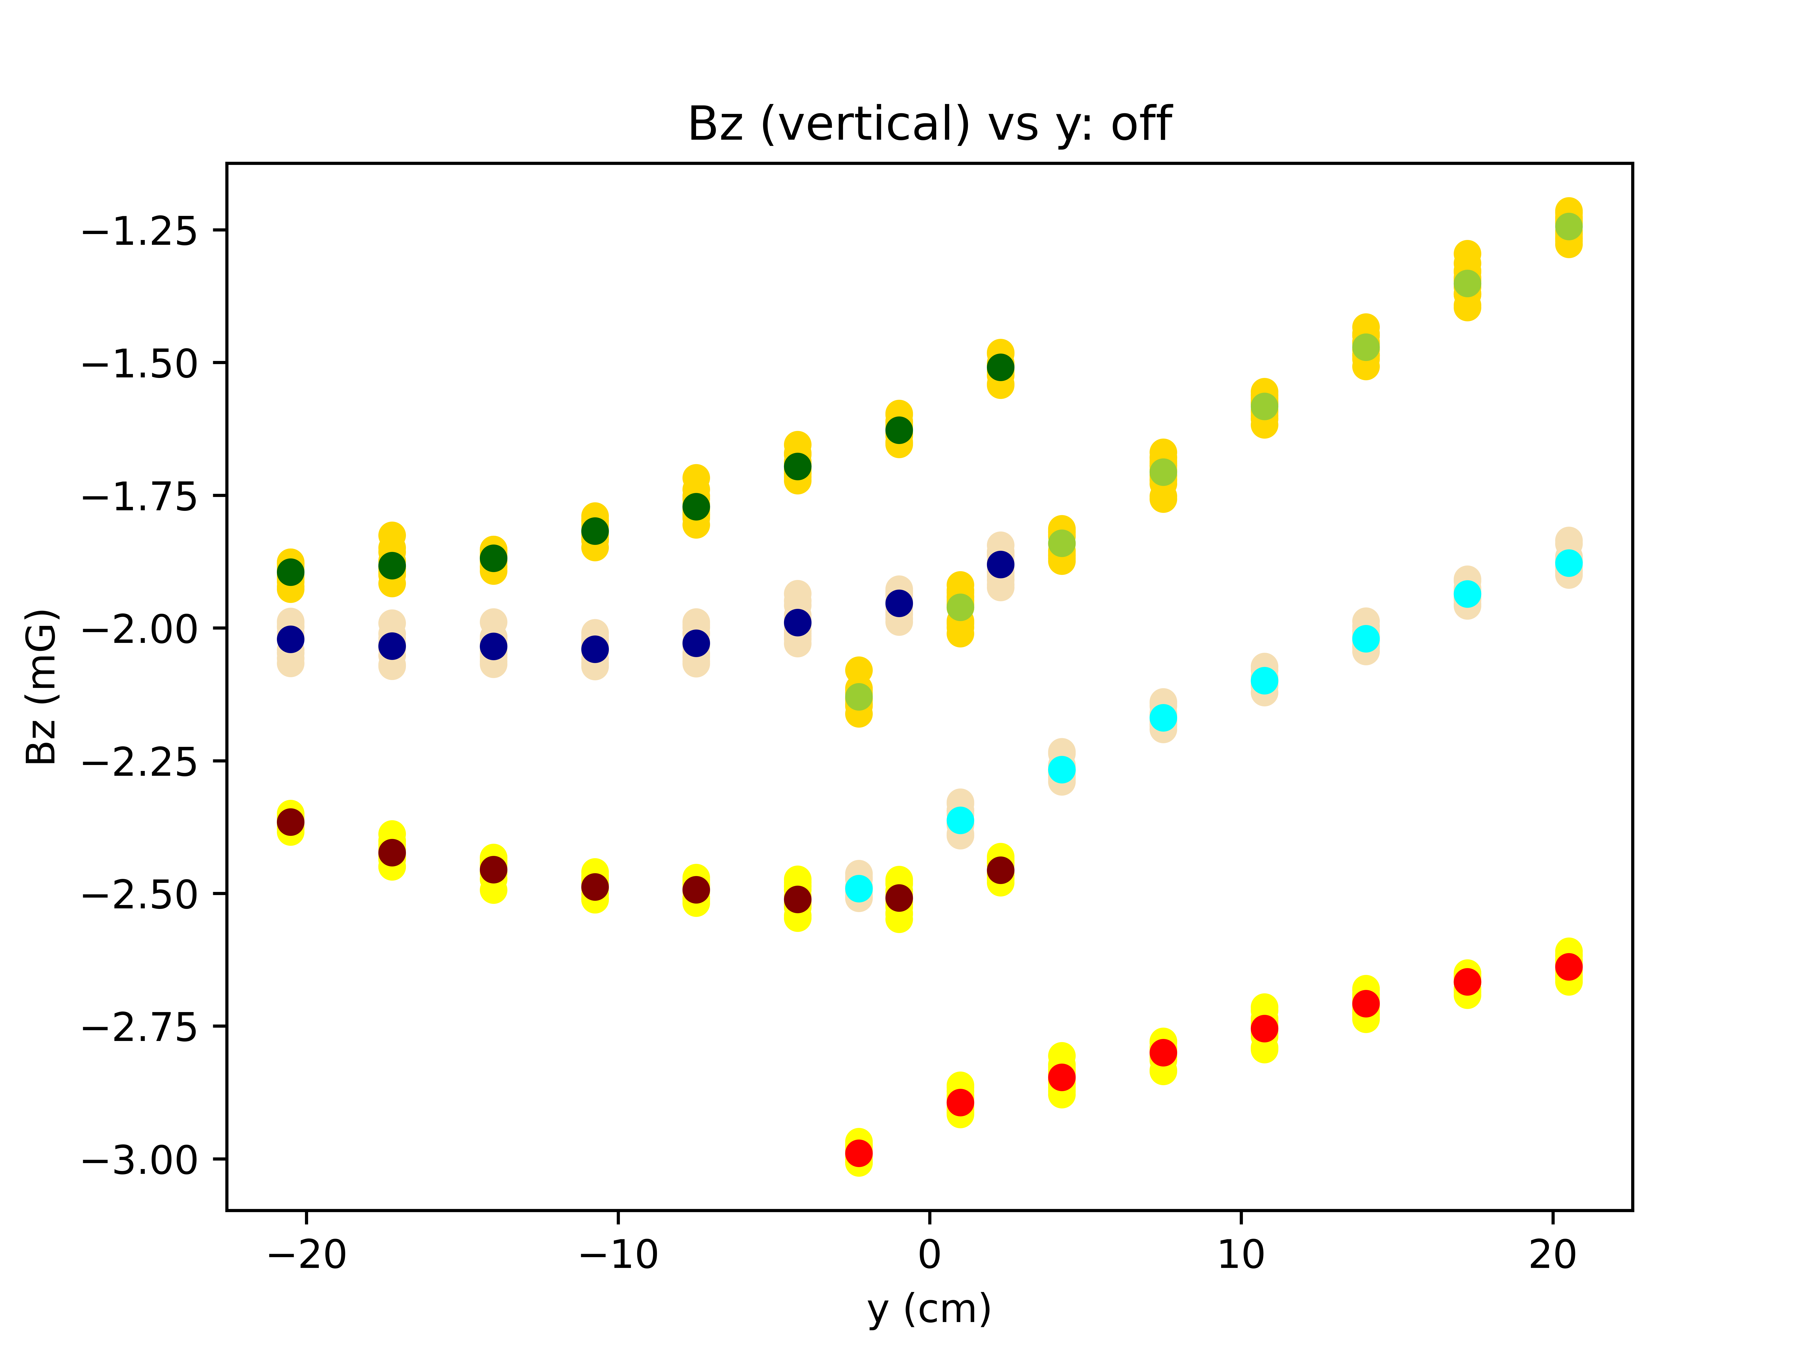
Data from 3/30.
Plots at three vertical heights: V=+3.9cm, V=0cm, V=-3.9cm. Data taken at a pi rotation is labeled in a darker color so the points can be distinguished.
B0 off. No time corrections.

Slide 5
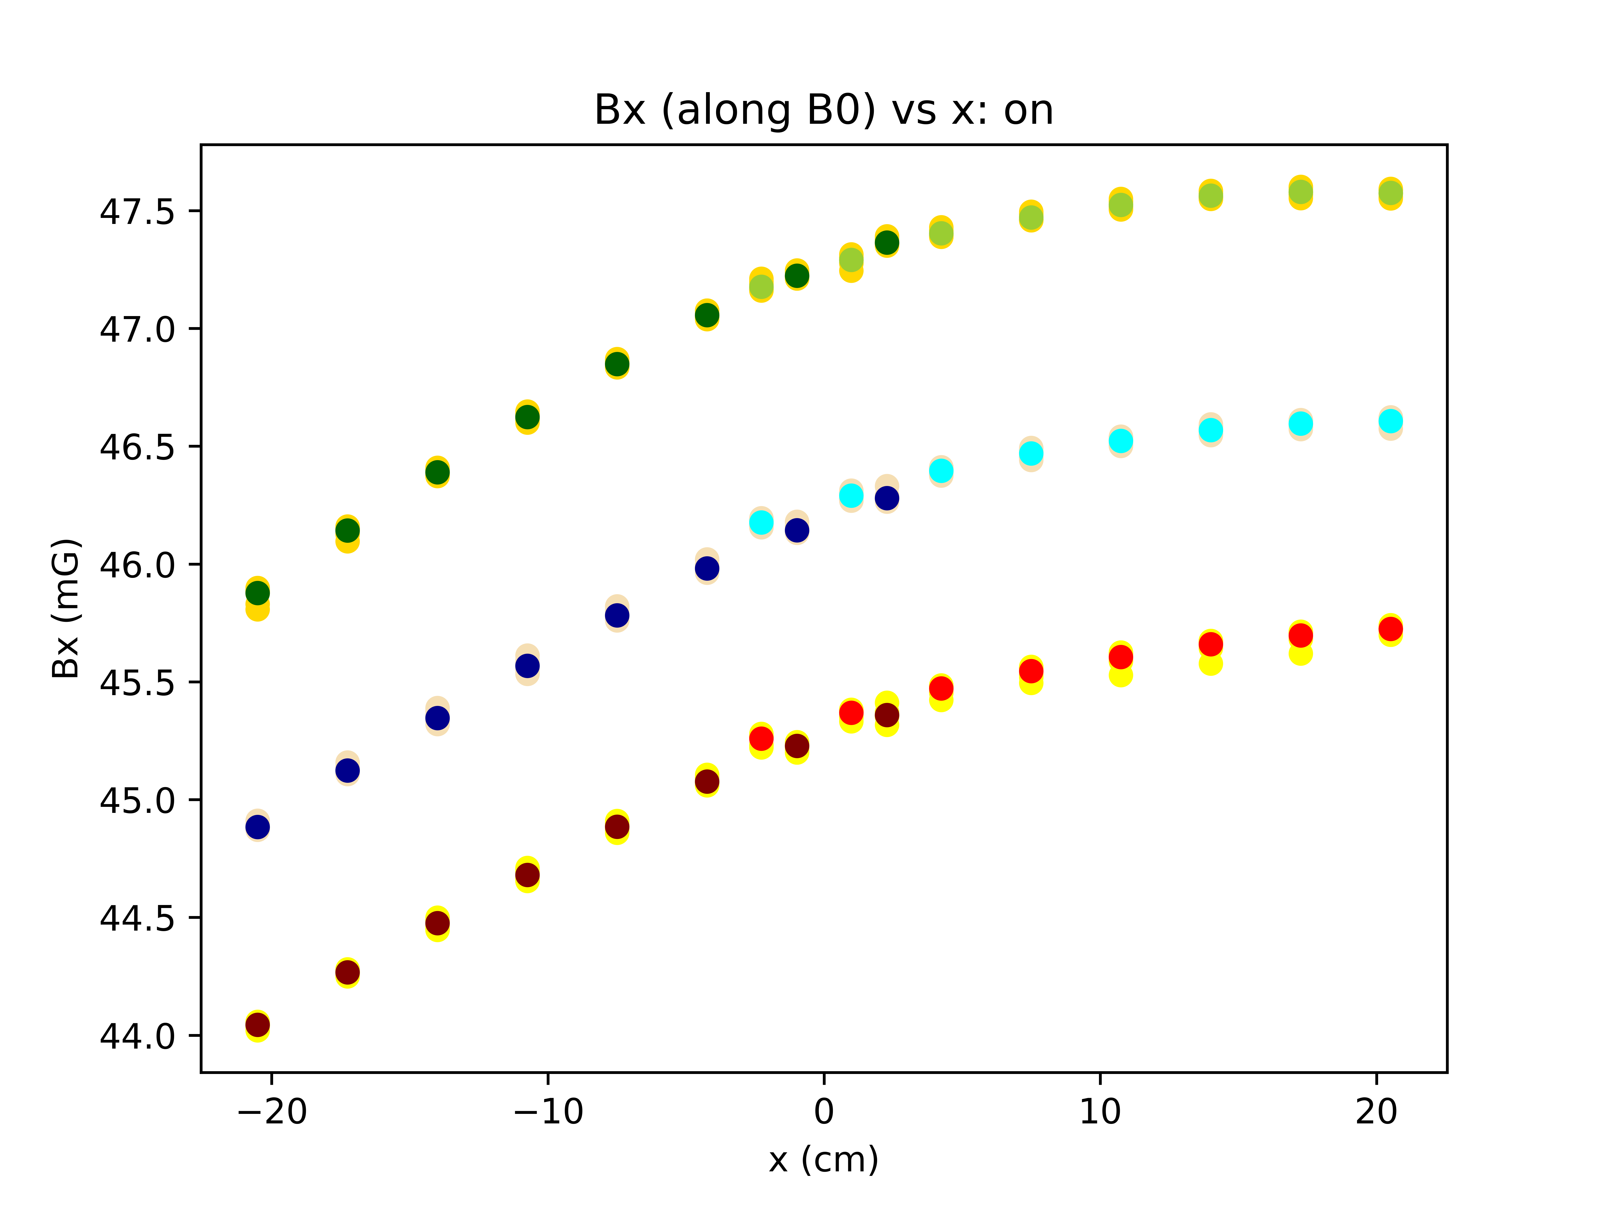
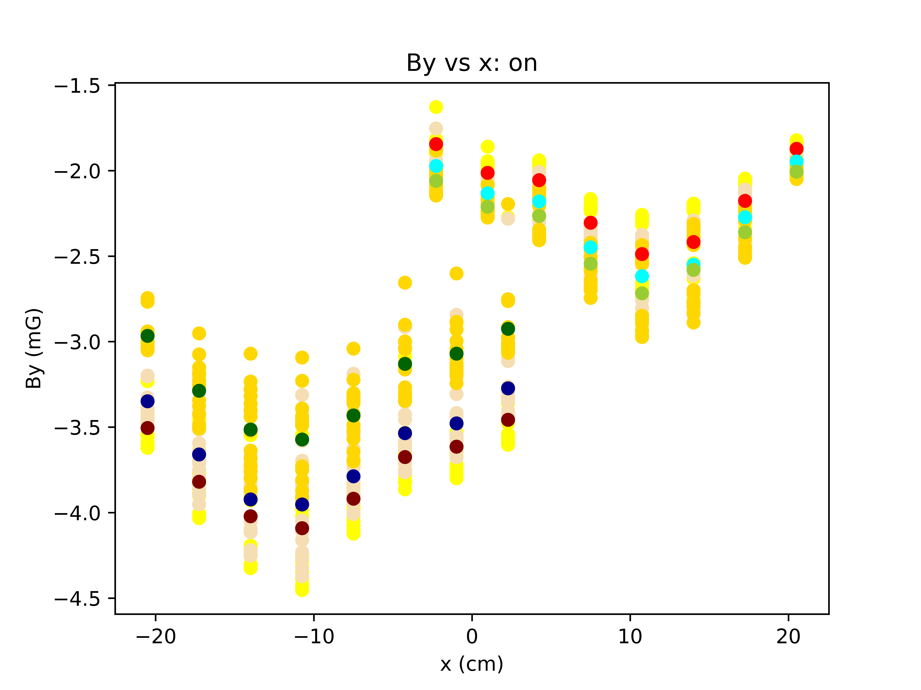
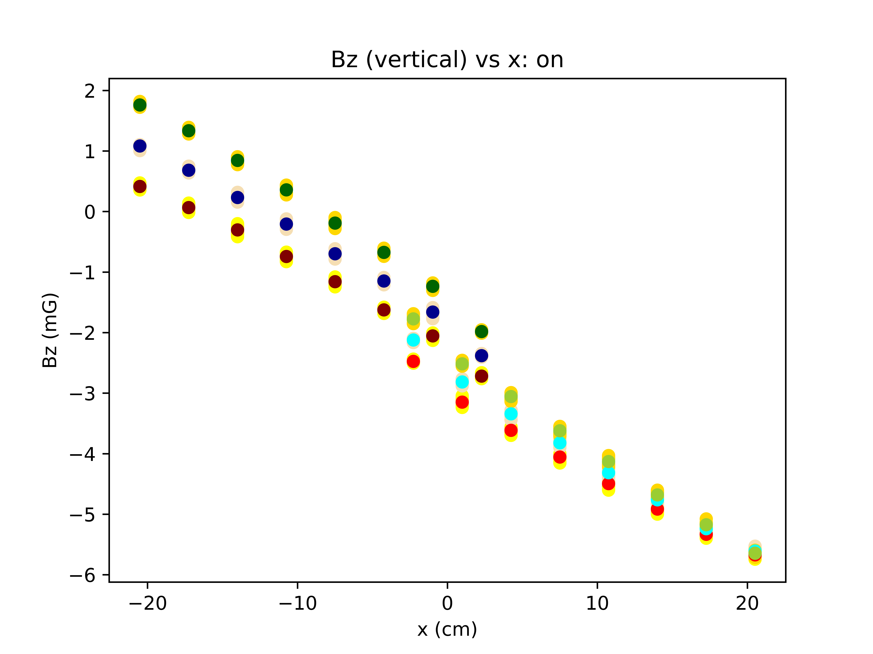
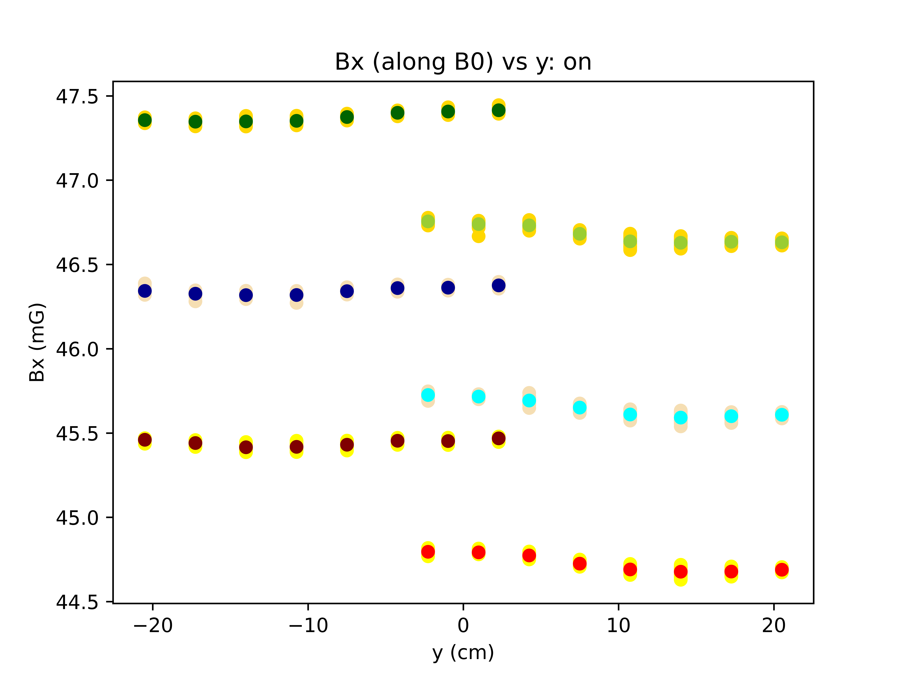
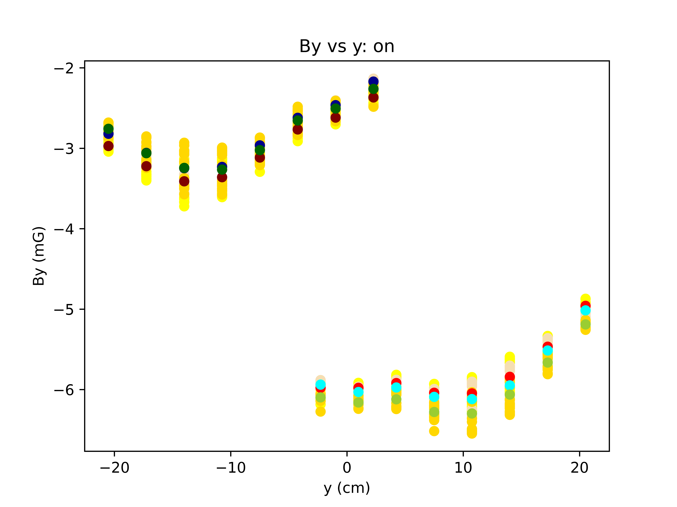
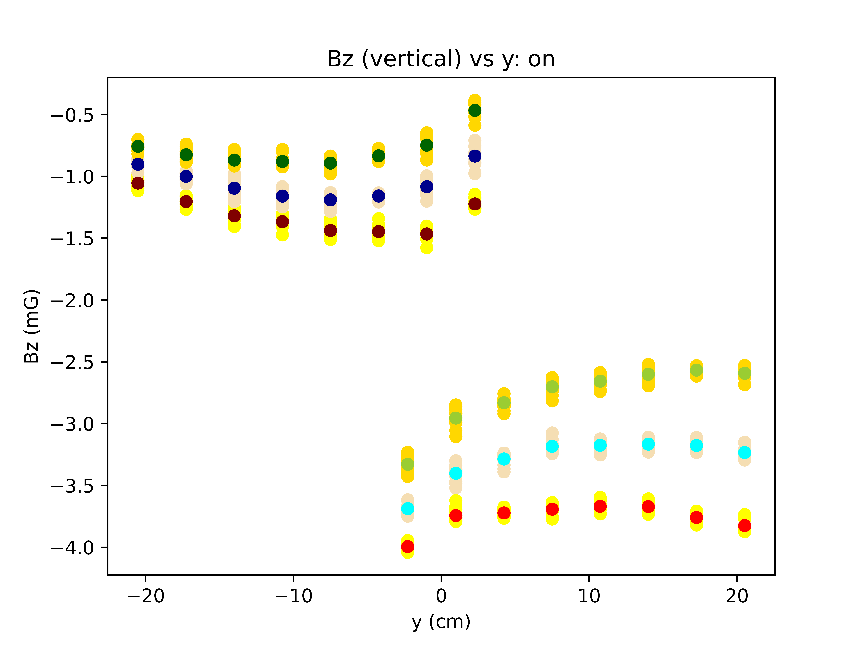
Data from 3/30.
Plots at three vertical heights: V=+3.9cm, V=0cm, V=-3.9cm. Data taken at a pi rotation is labeled in a darker color so the points can be distinguished.
B0 on. No time corrections

Slide 6
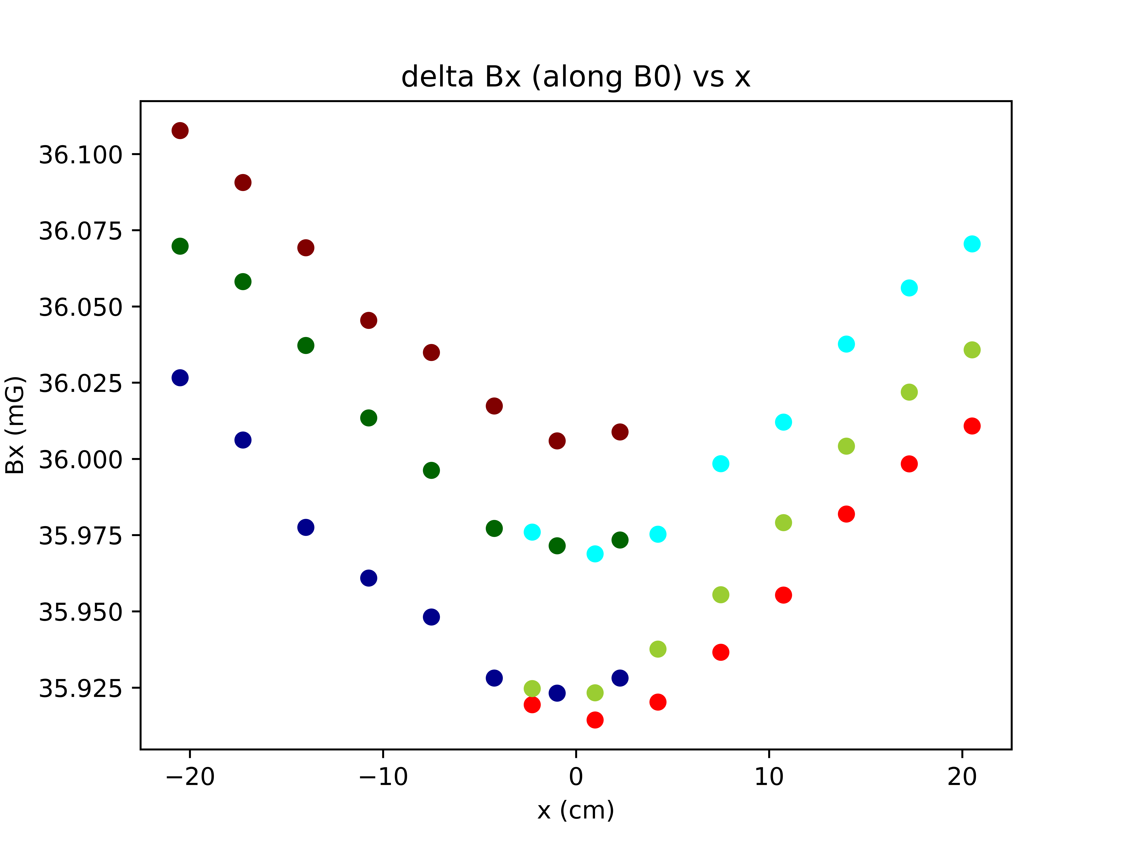
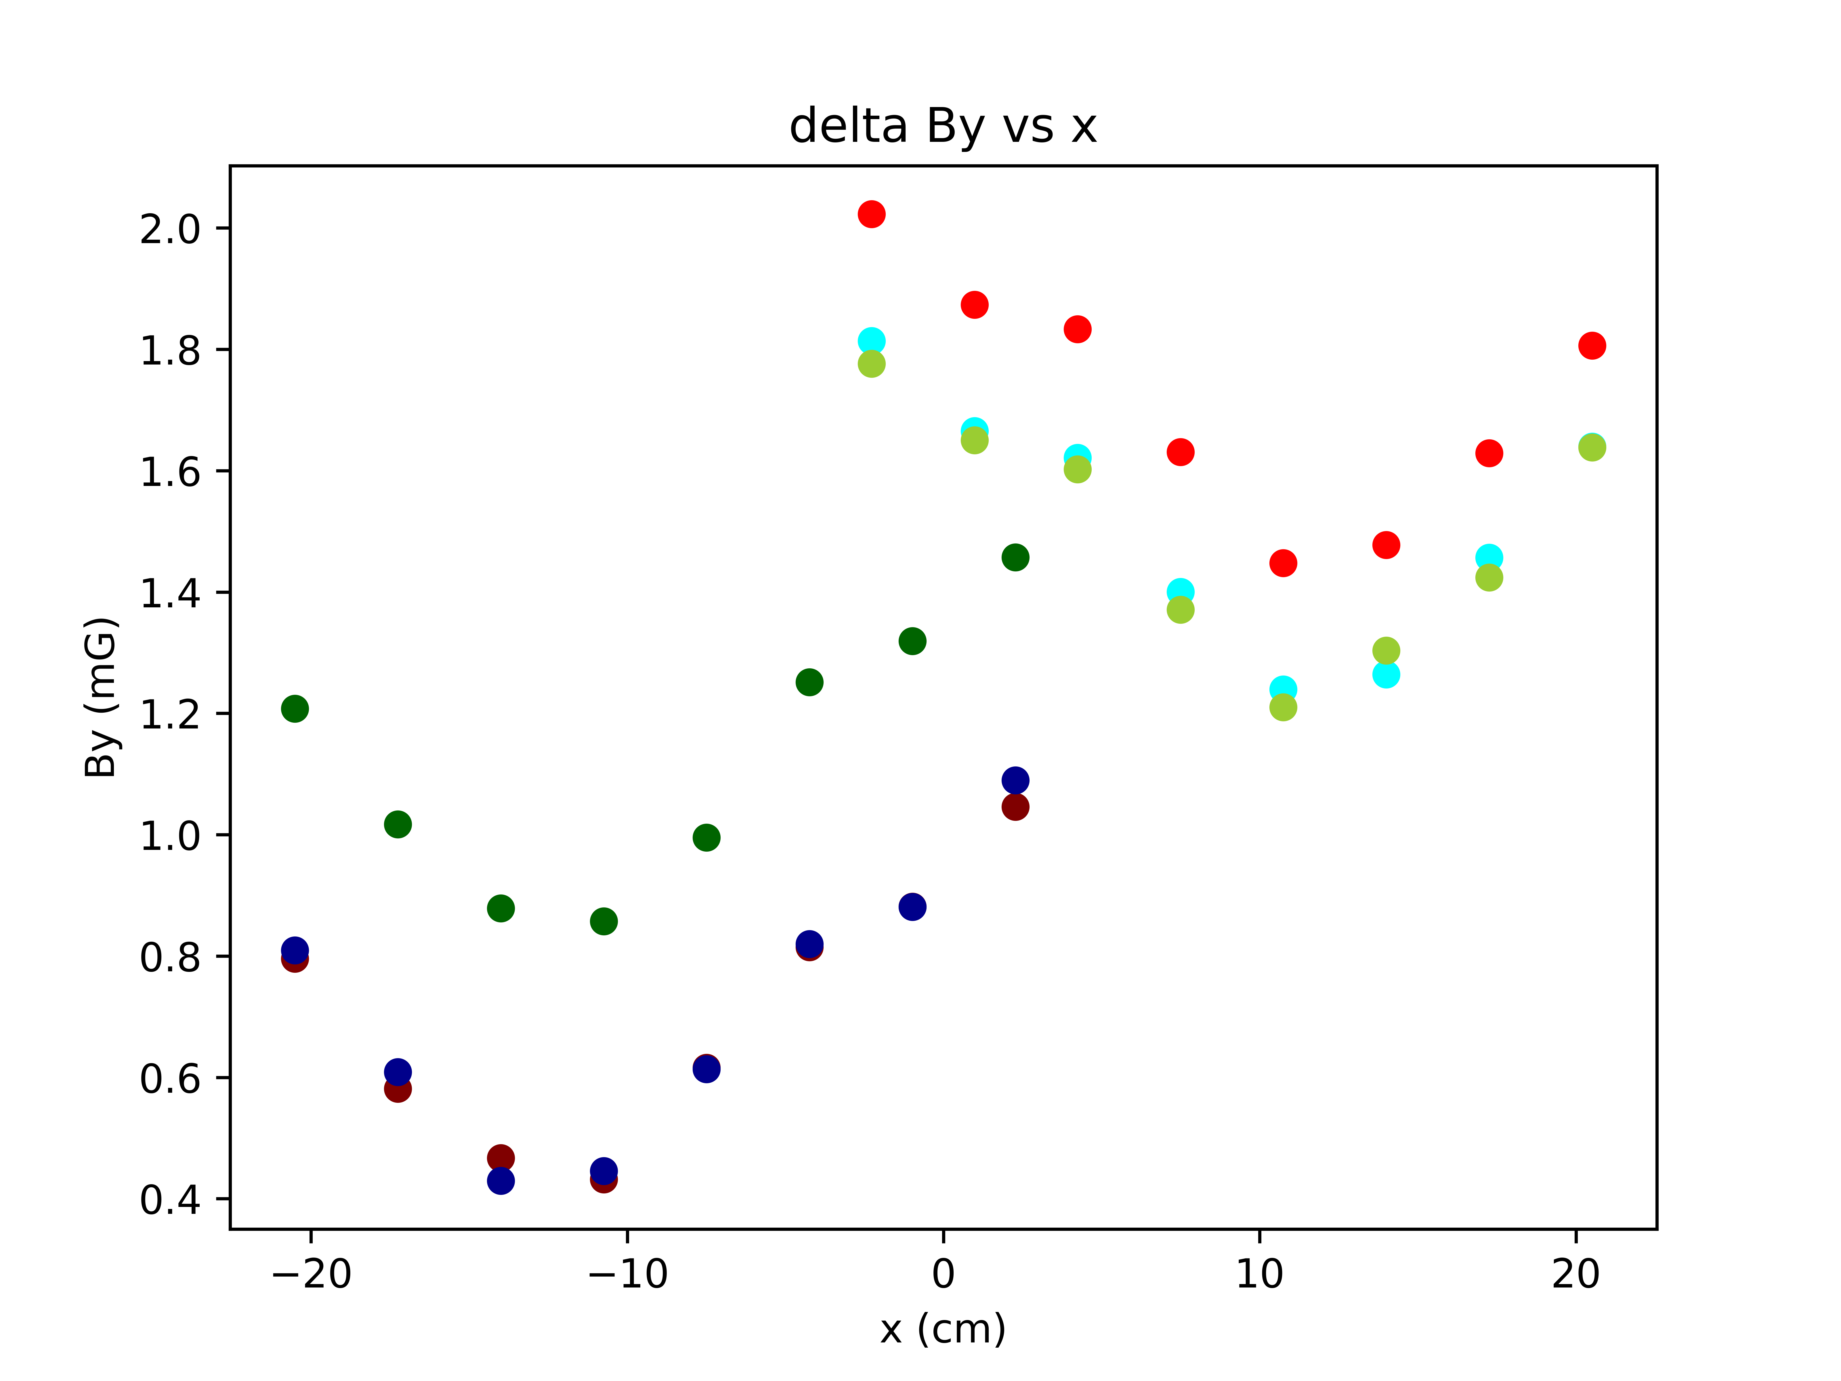
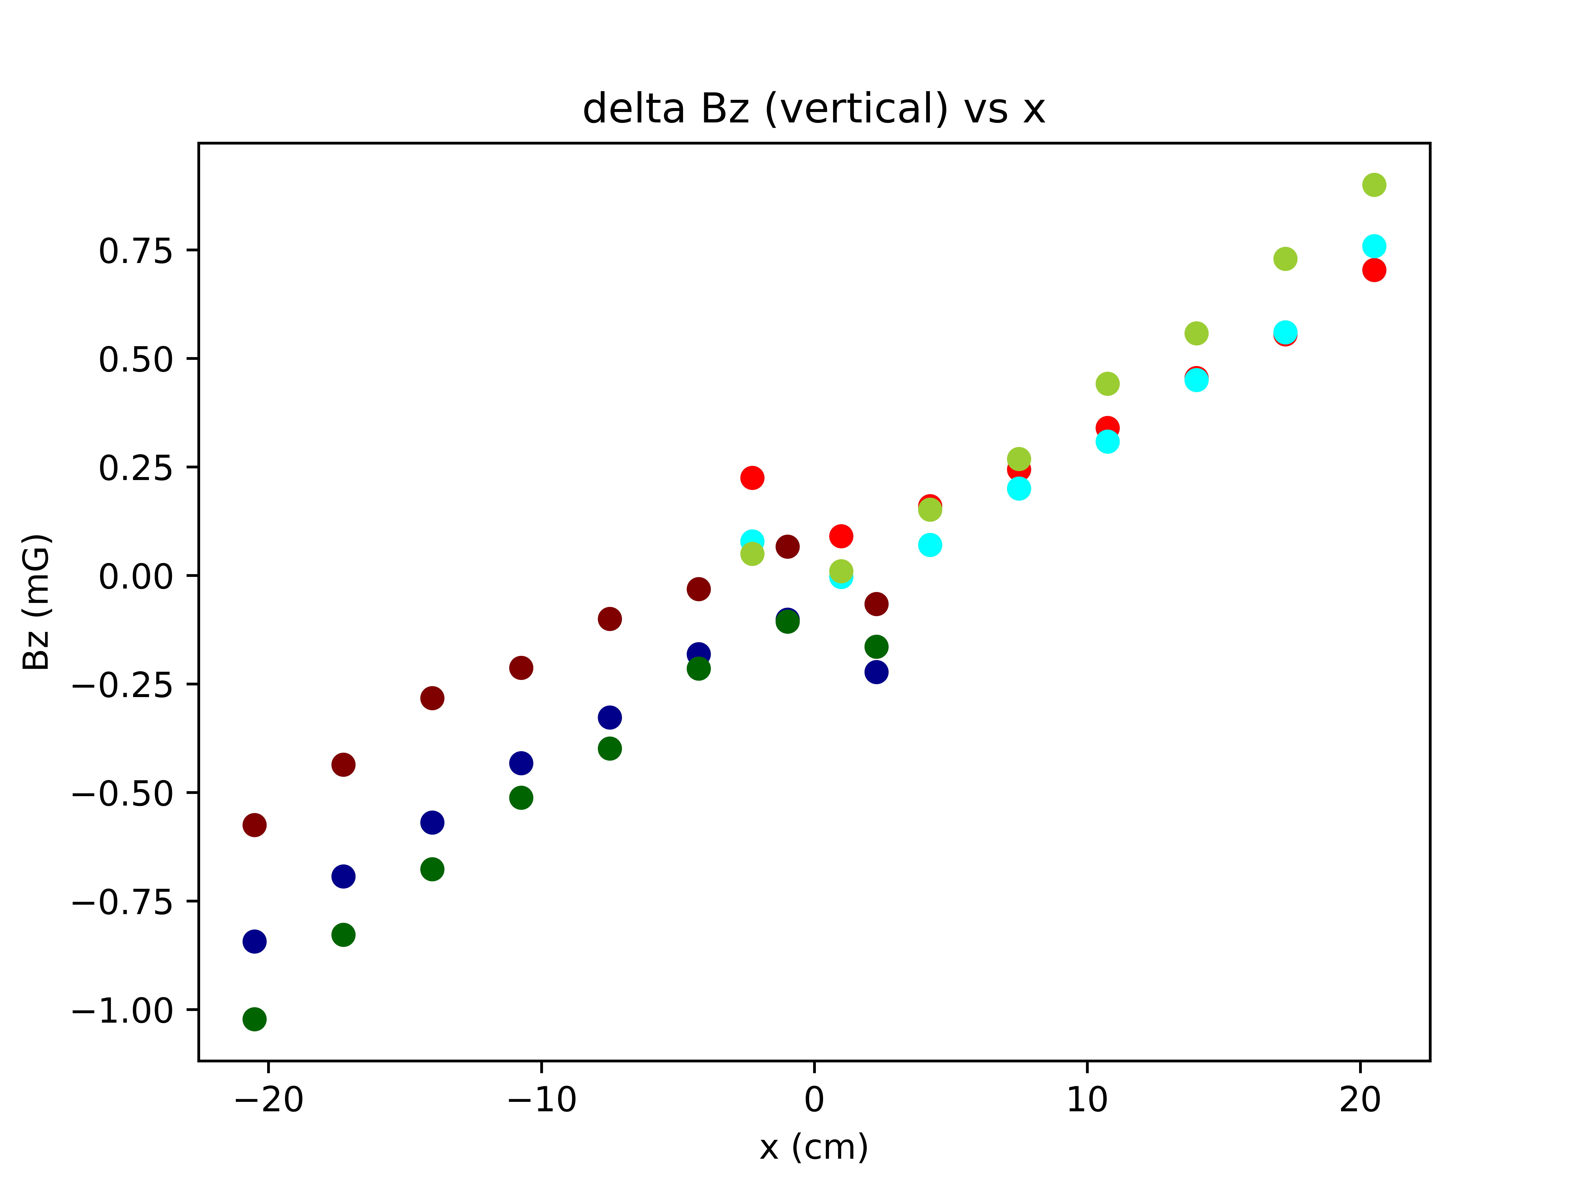
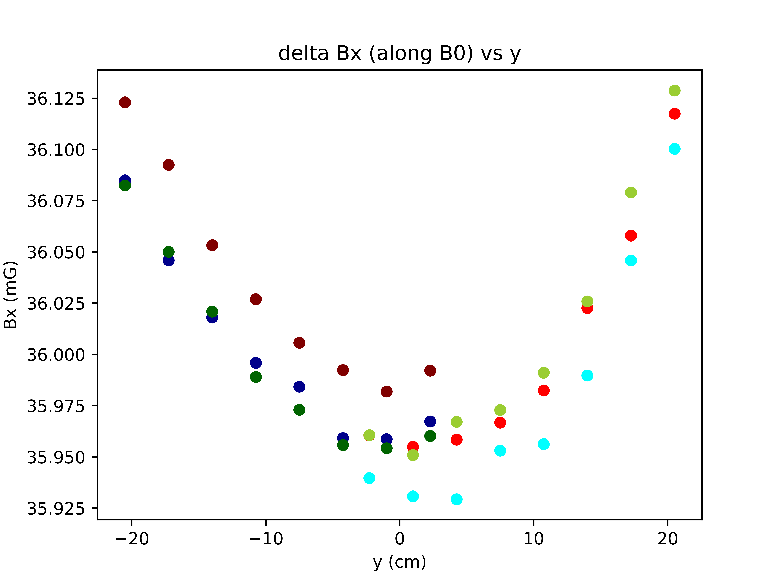
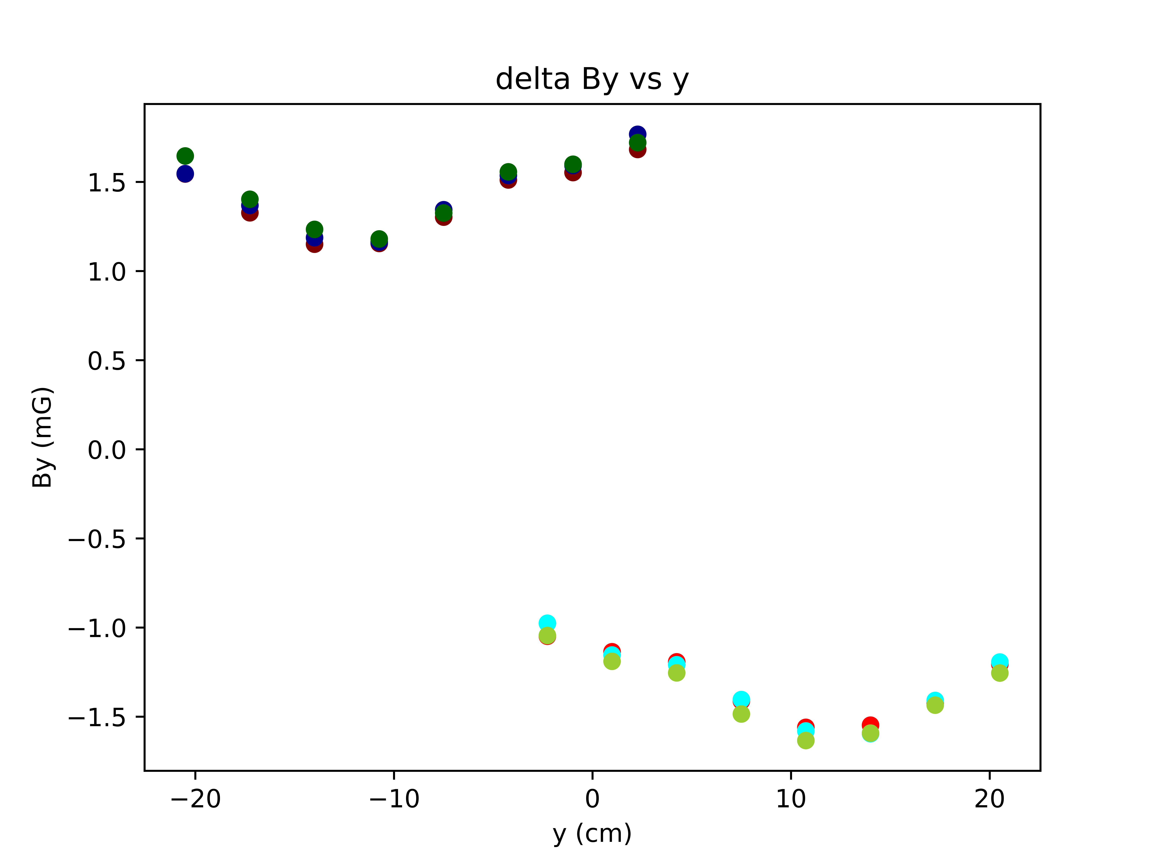
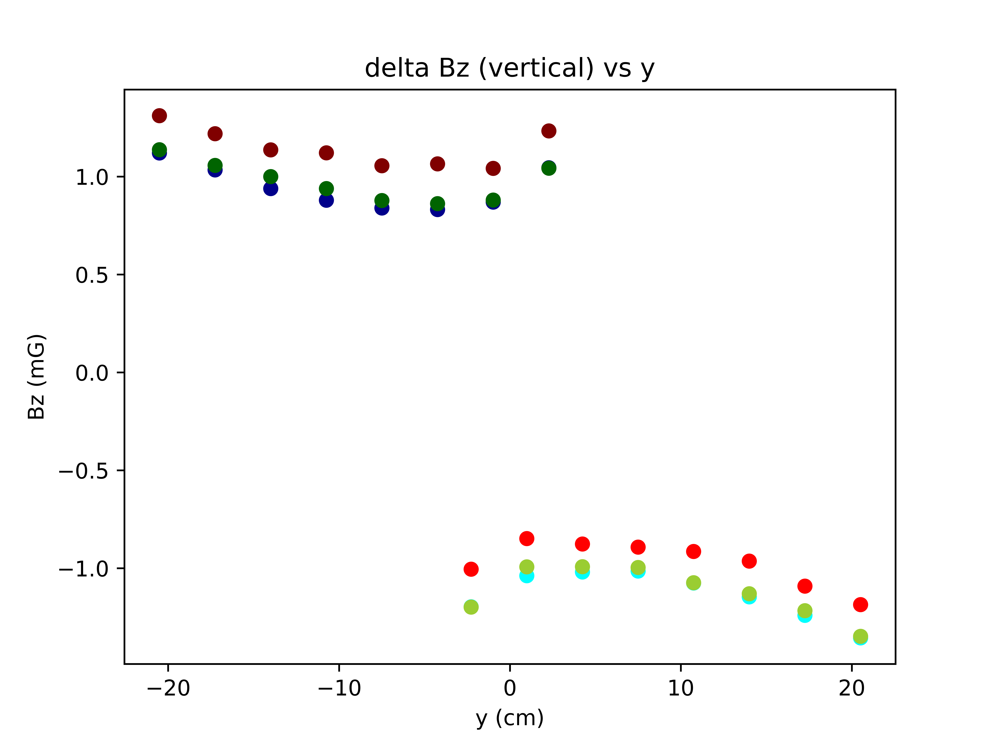
Data from 3/30.
Plots at three vertical heights: V=+3.9cm, V=0cm, V=-3.9cm. Data taken at a pi rotation is labeled in a darker color so the points can be distinguished.
Difference plots. No time corrections.

Slide 7
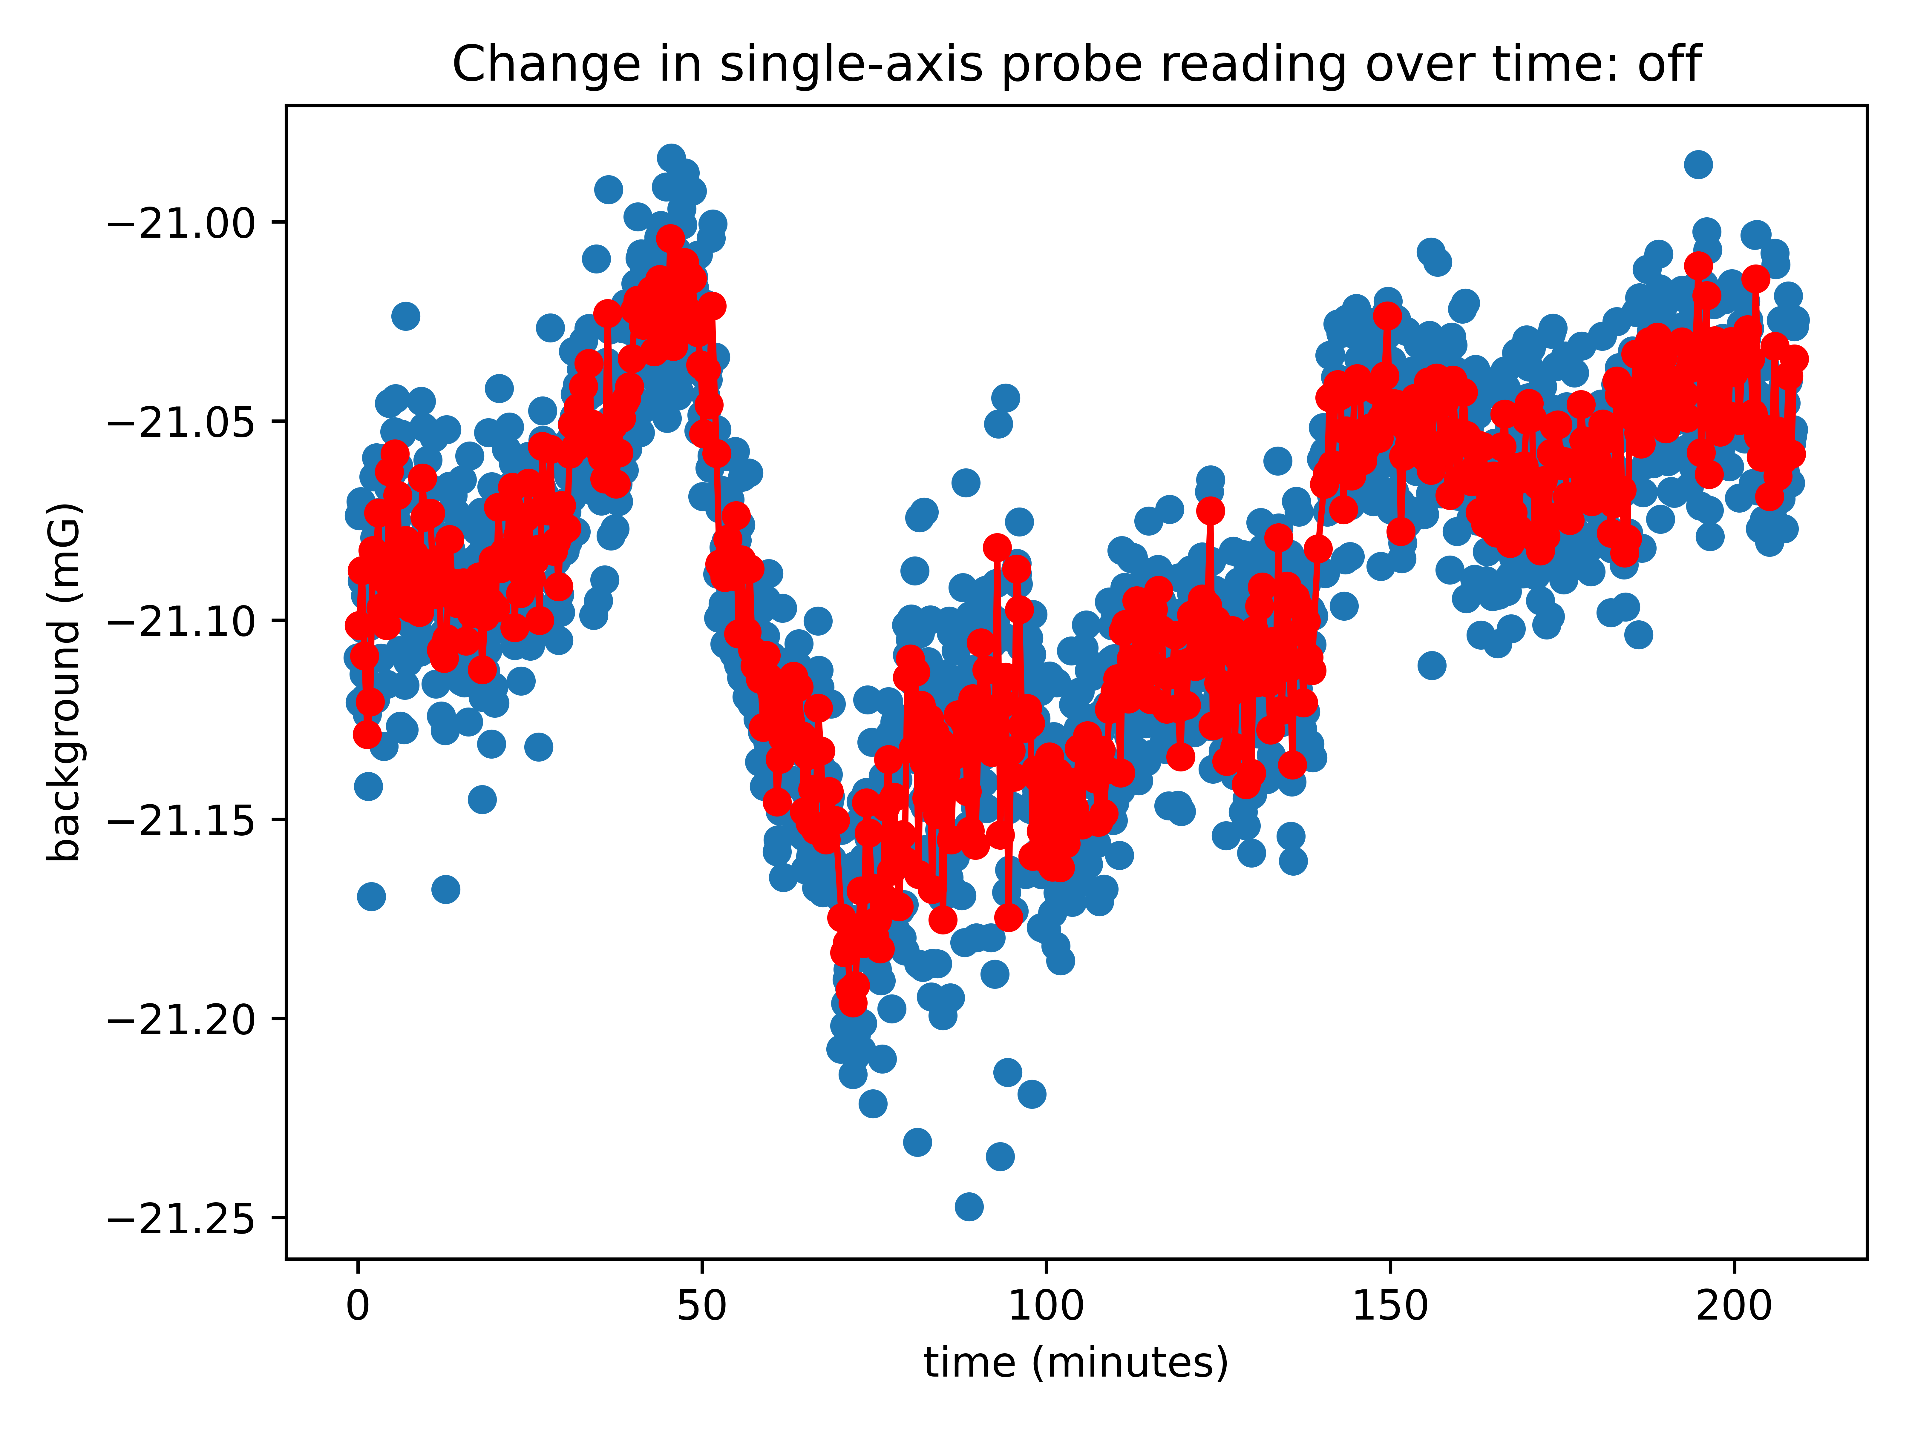
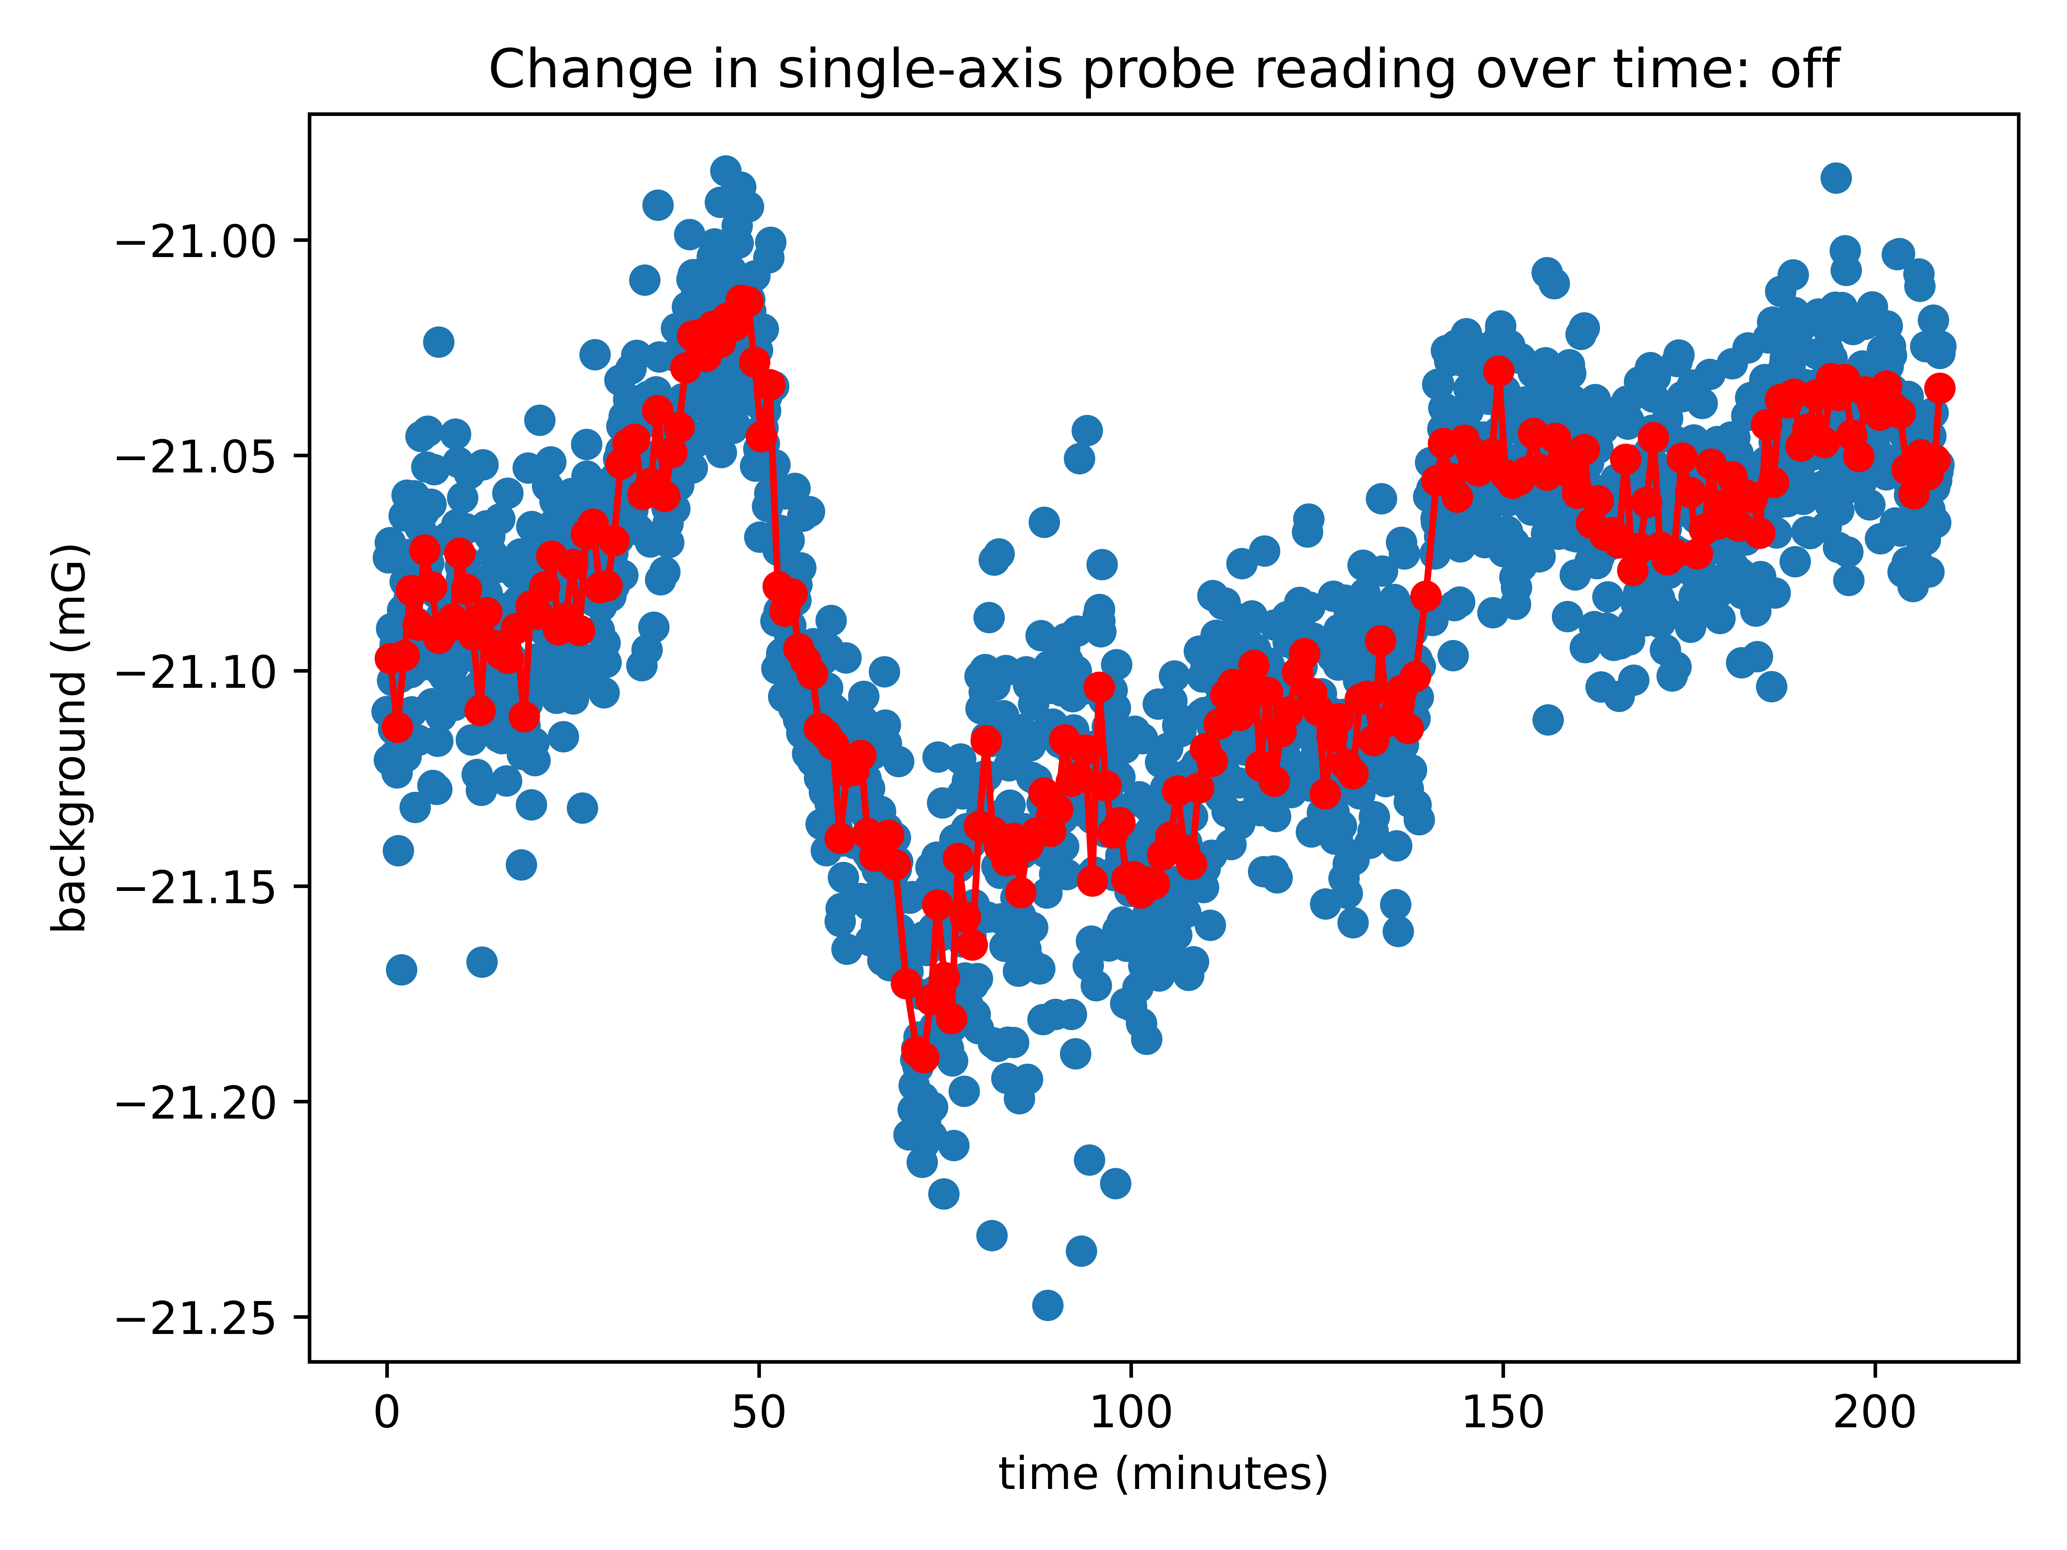
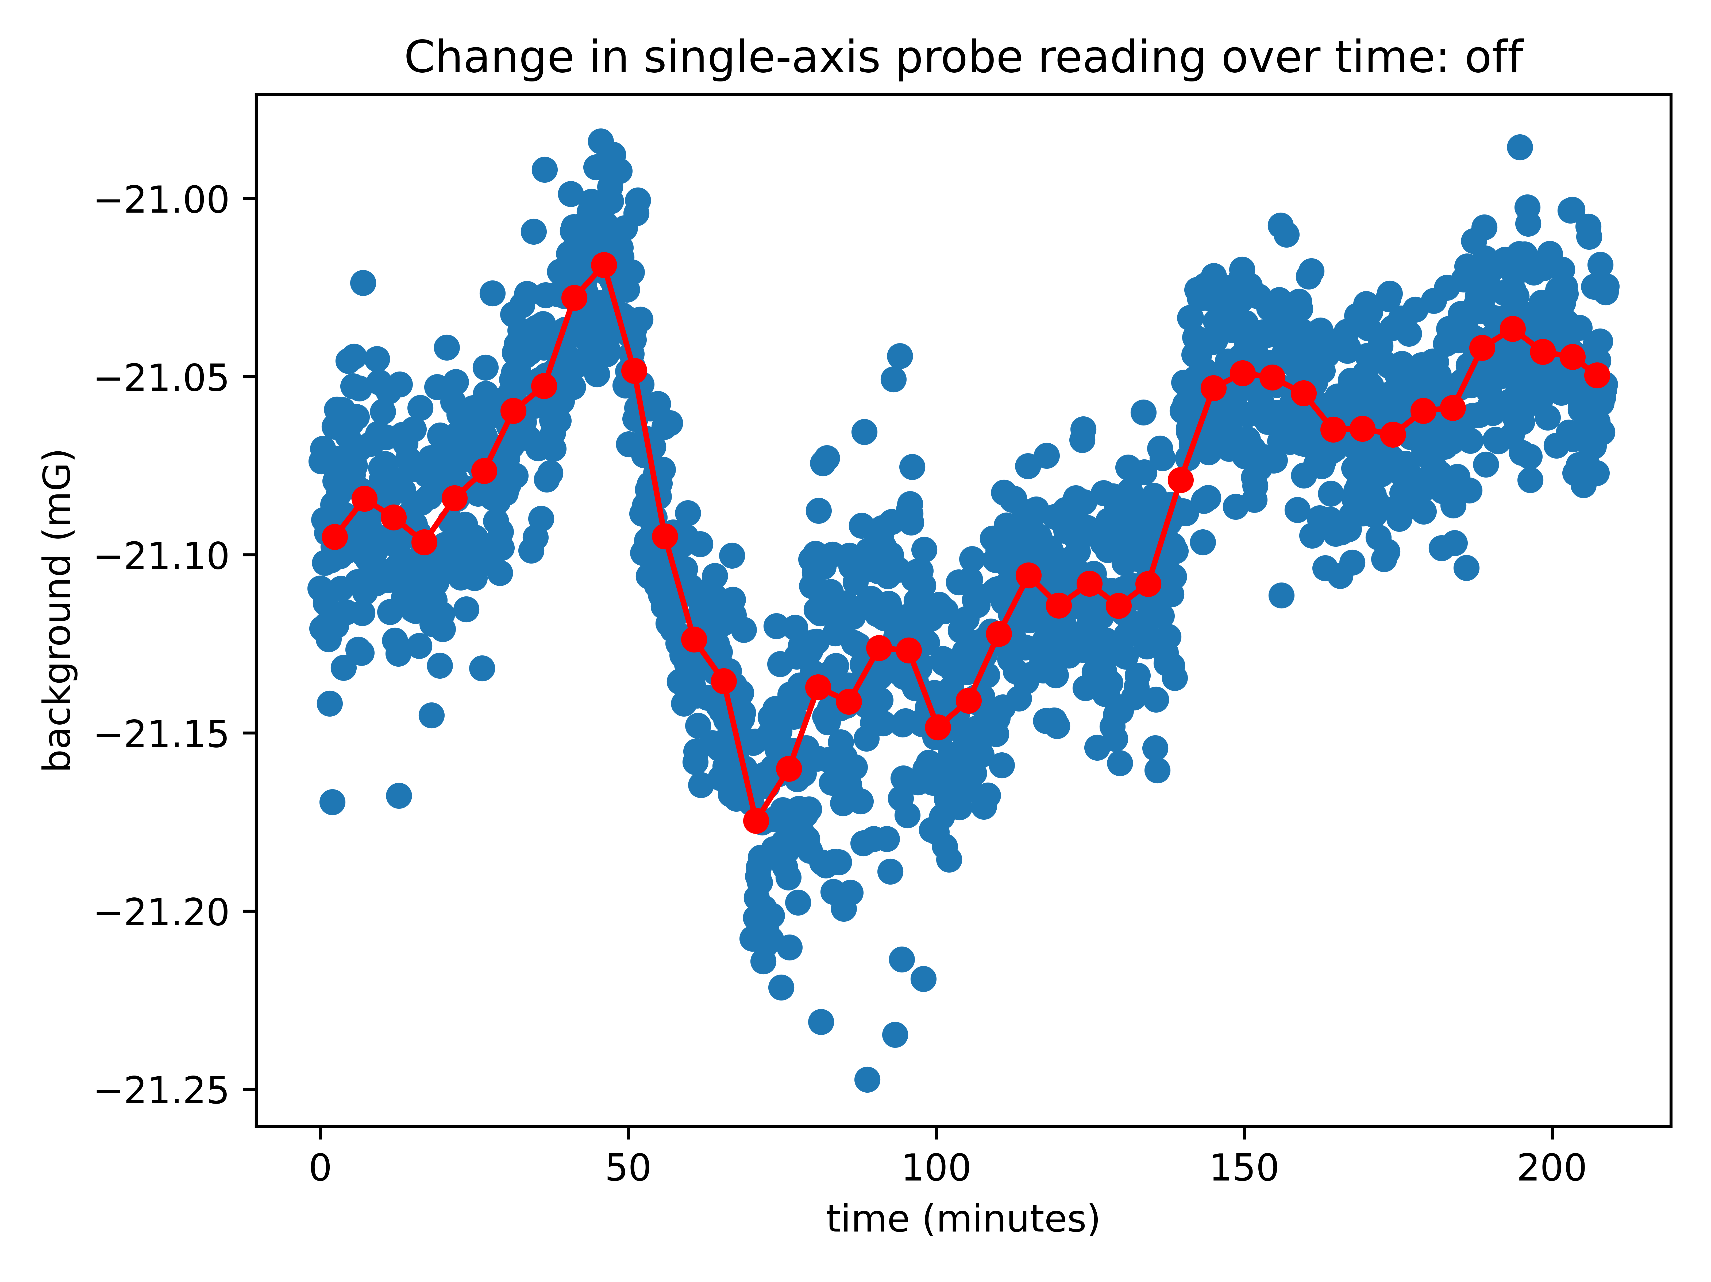
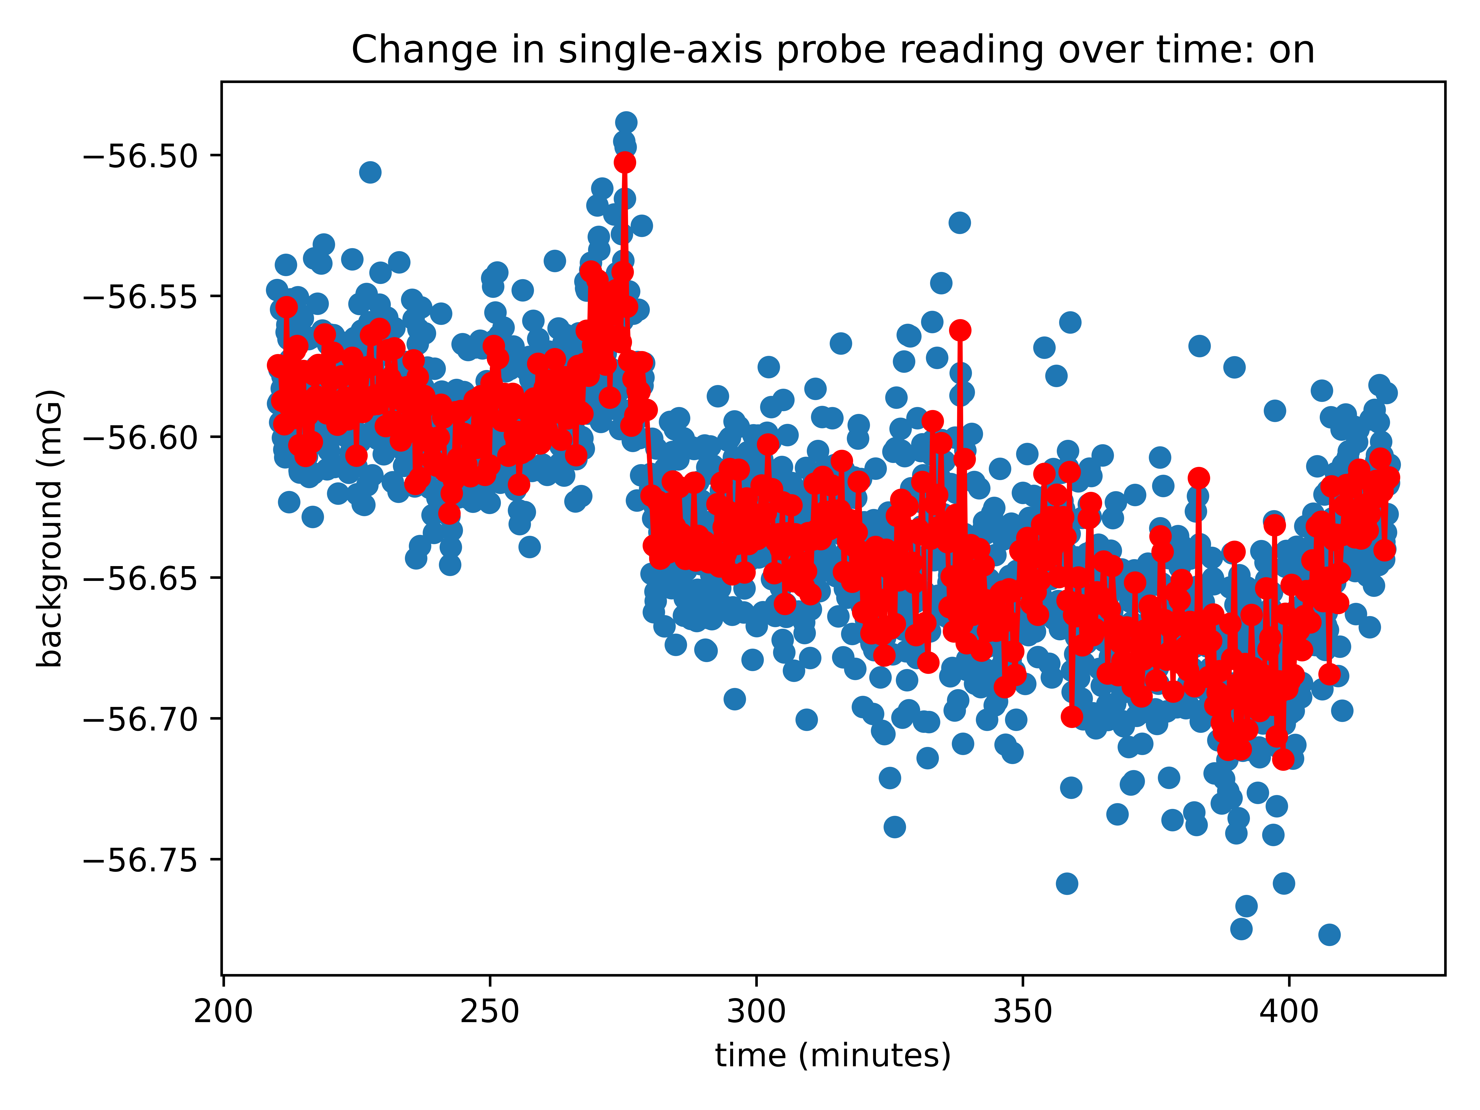
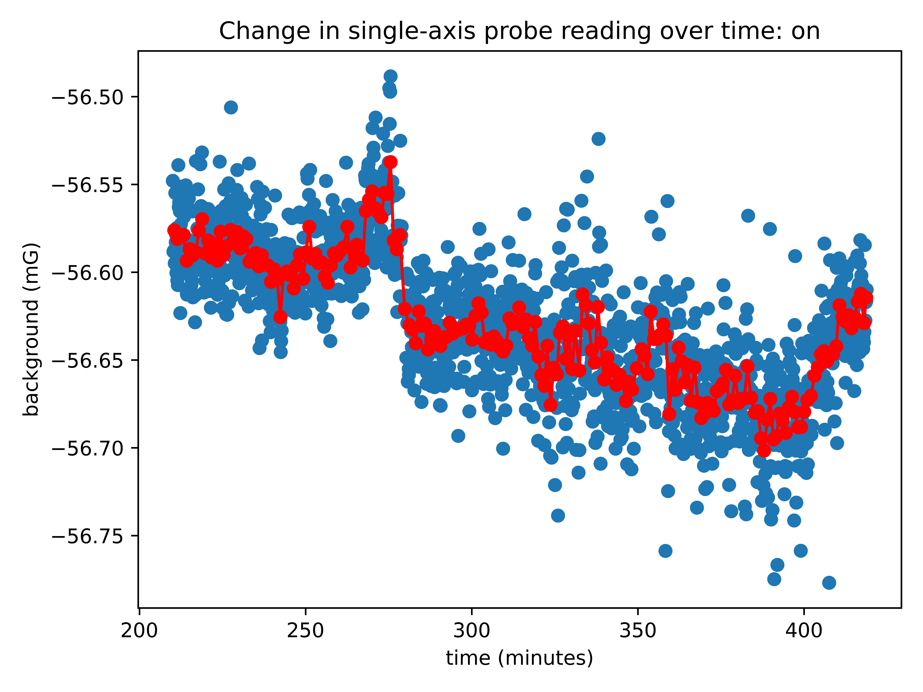
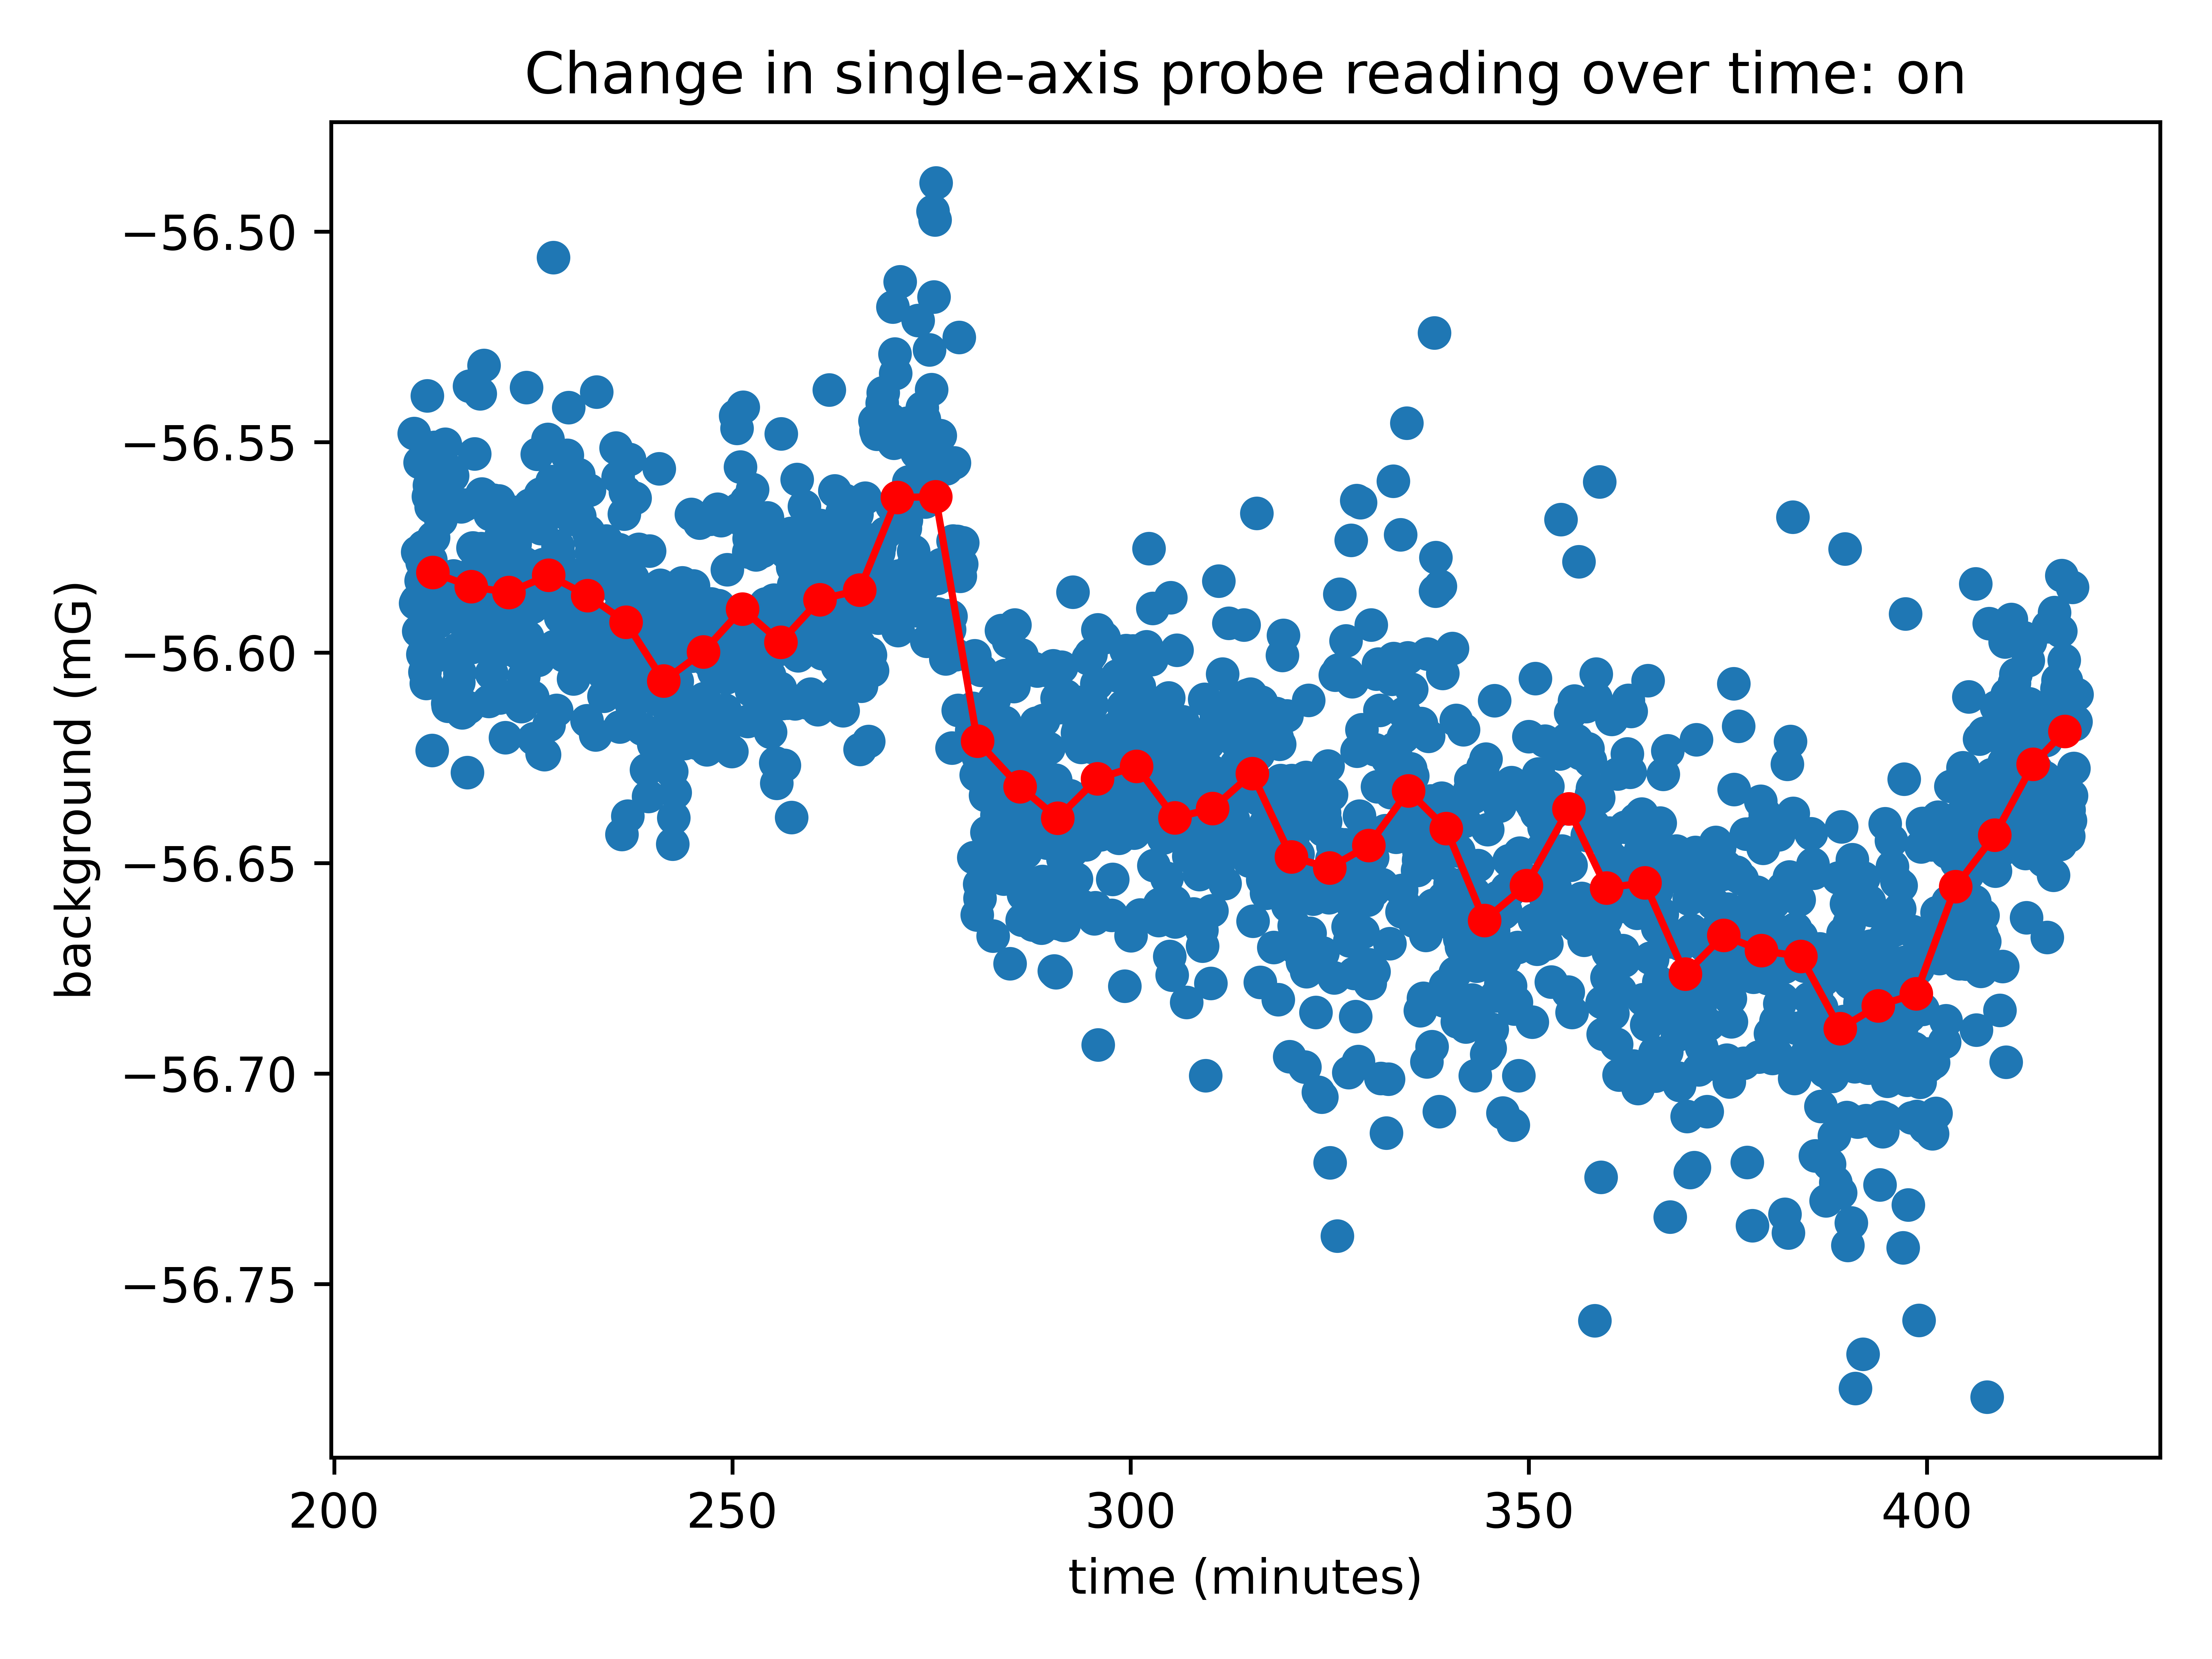
Using the single-axis probe output to correct for time-varying background in Bx.
On and off backgrounds. I averaged over intervals of 30s, 60s, 300s and compared to see if the interval size affected the results.
30s
60s
300s
30s
60s
300s

Slide 8
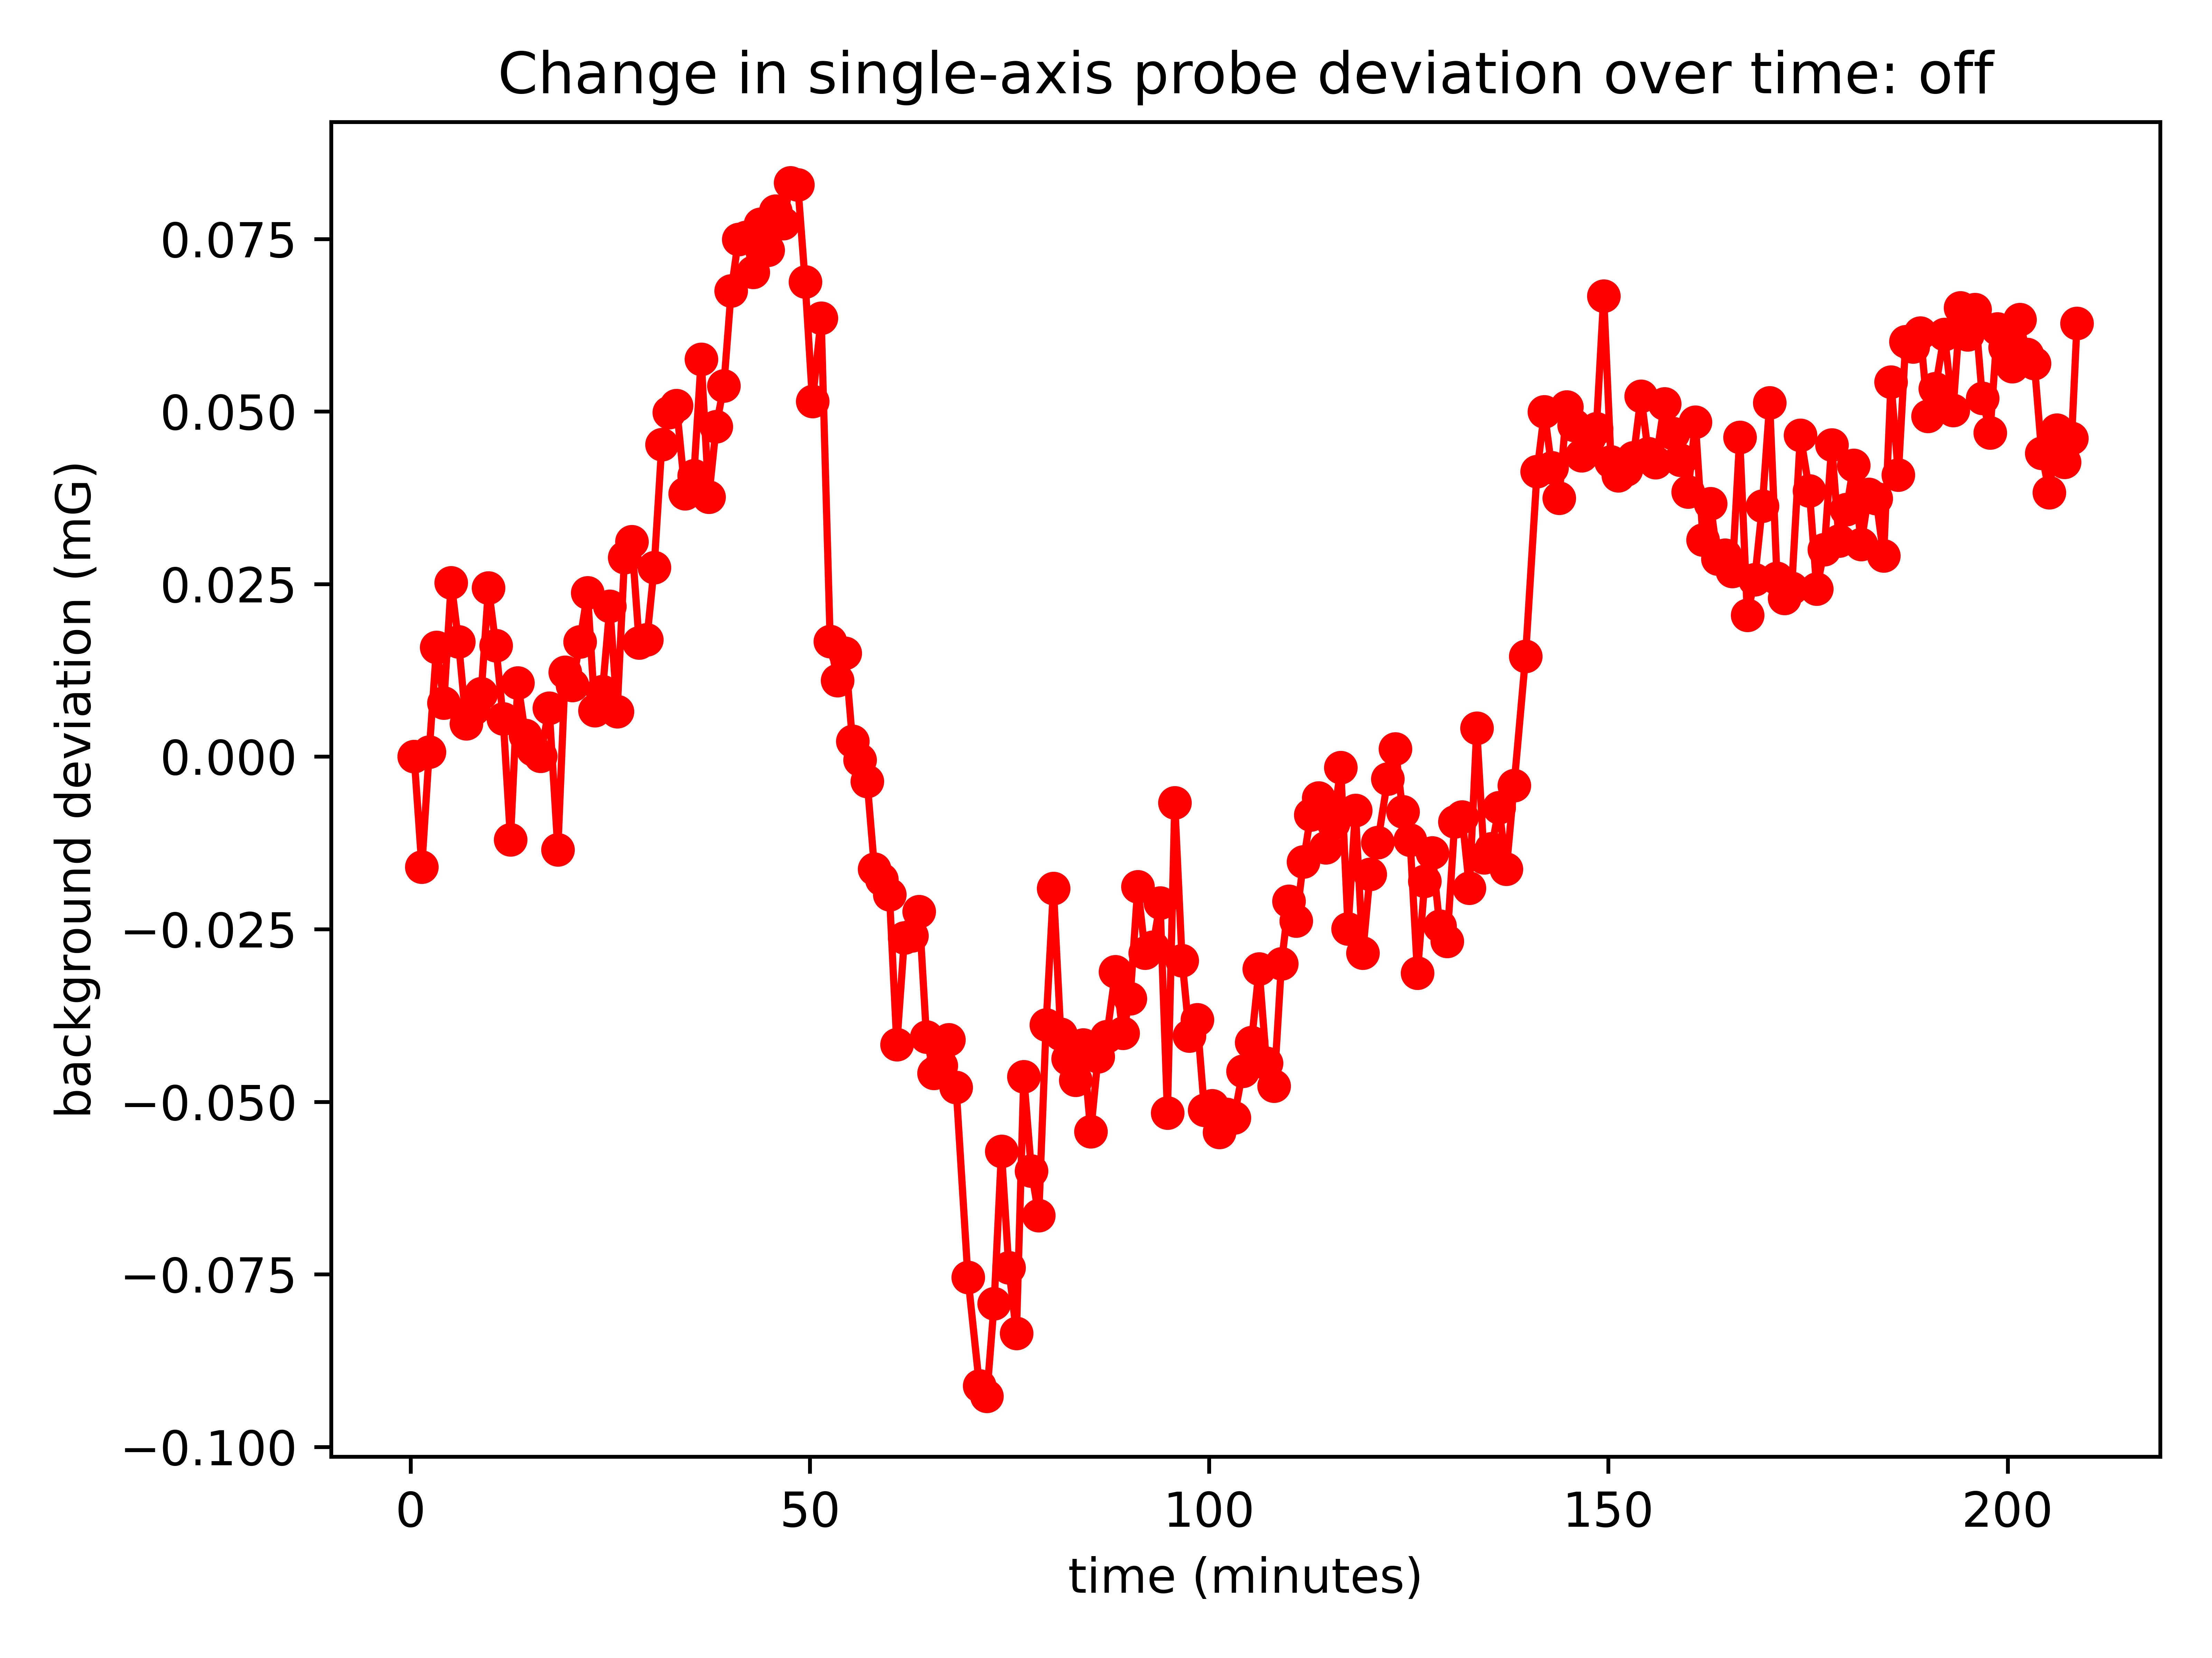
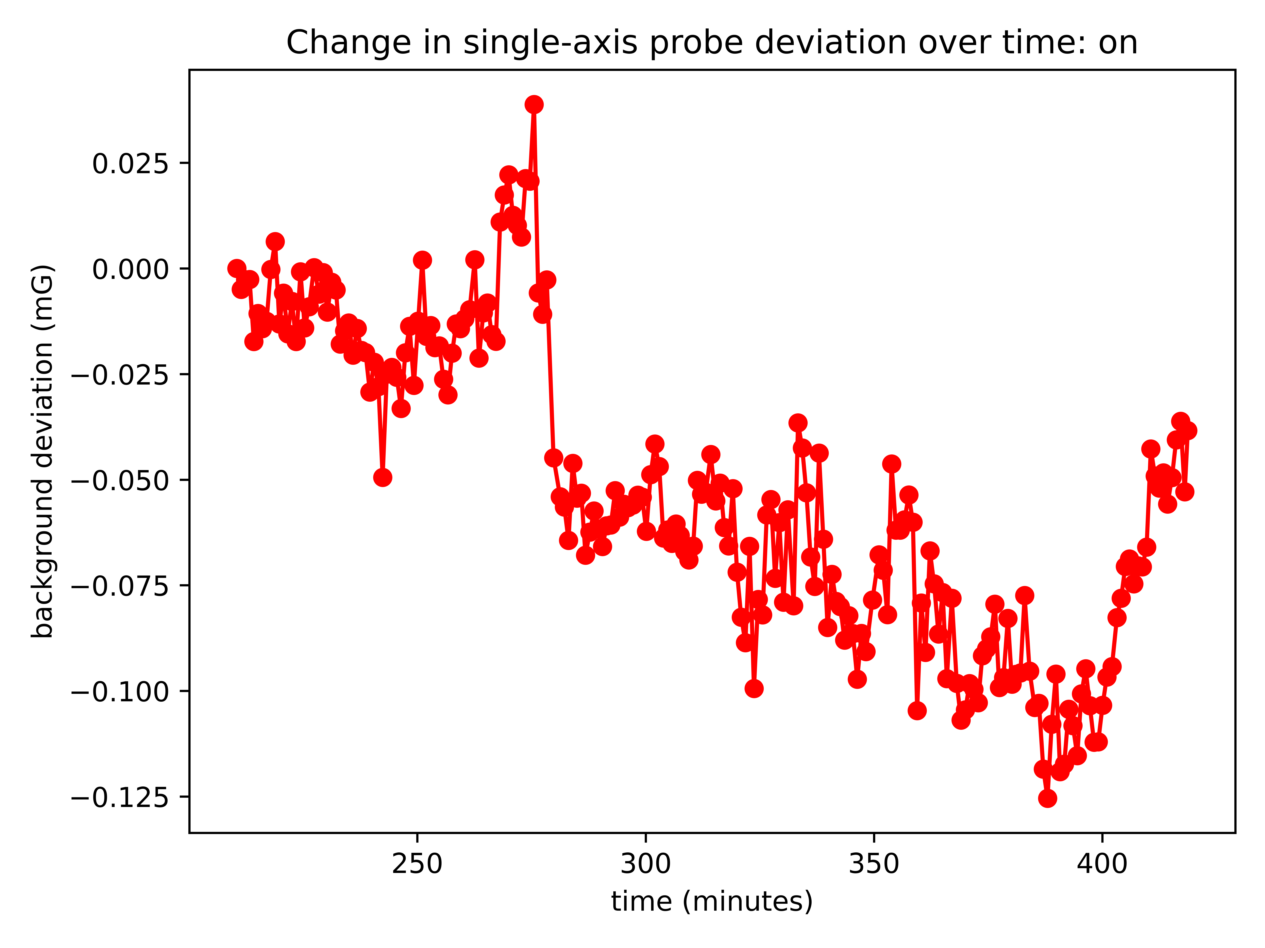
Using the single-axis probe output to correct for time-varying background in Bx.
Took the difference relative to the first interval value—just care about relative differences between points, not overall vertical shift of all points.

Slide 9
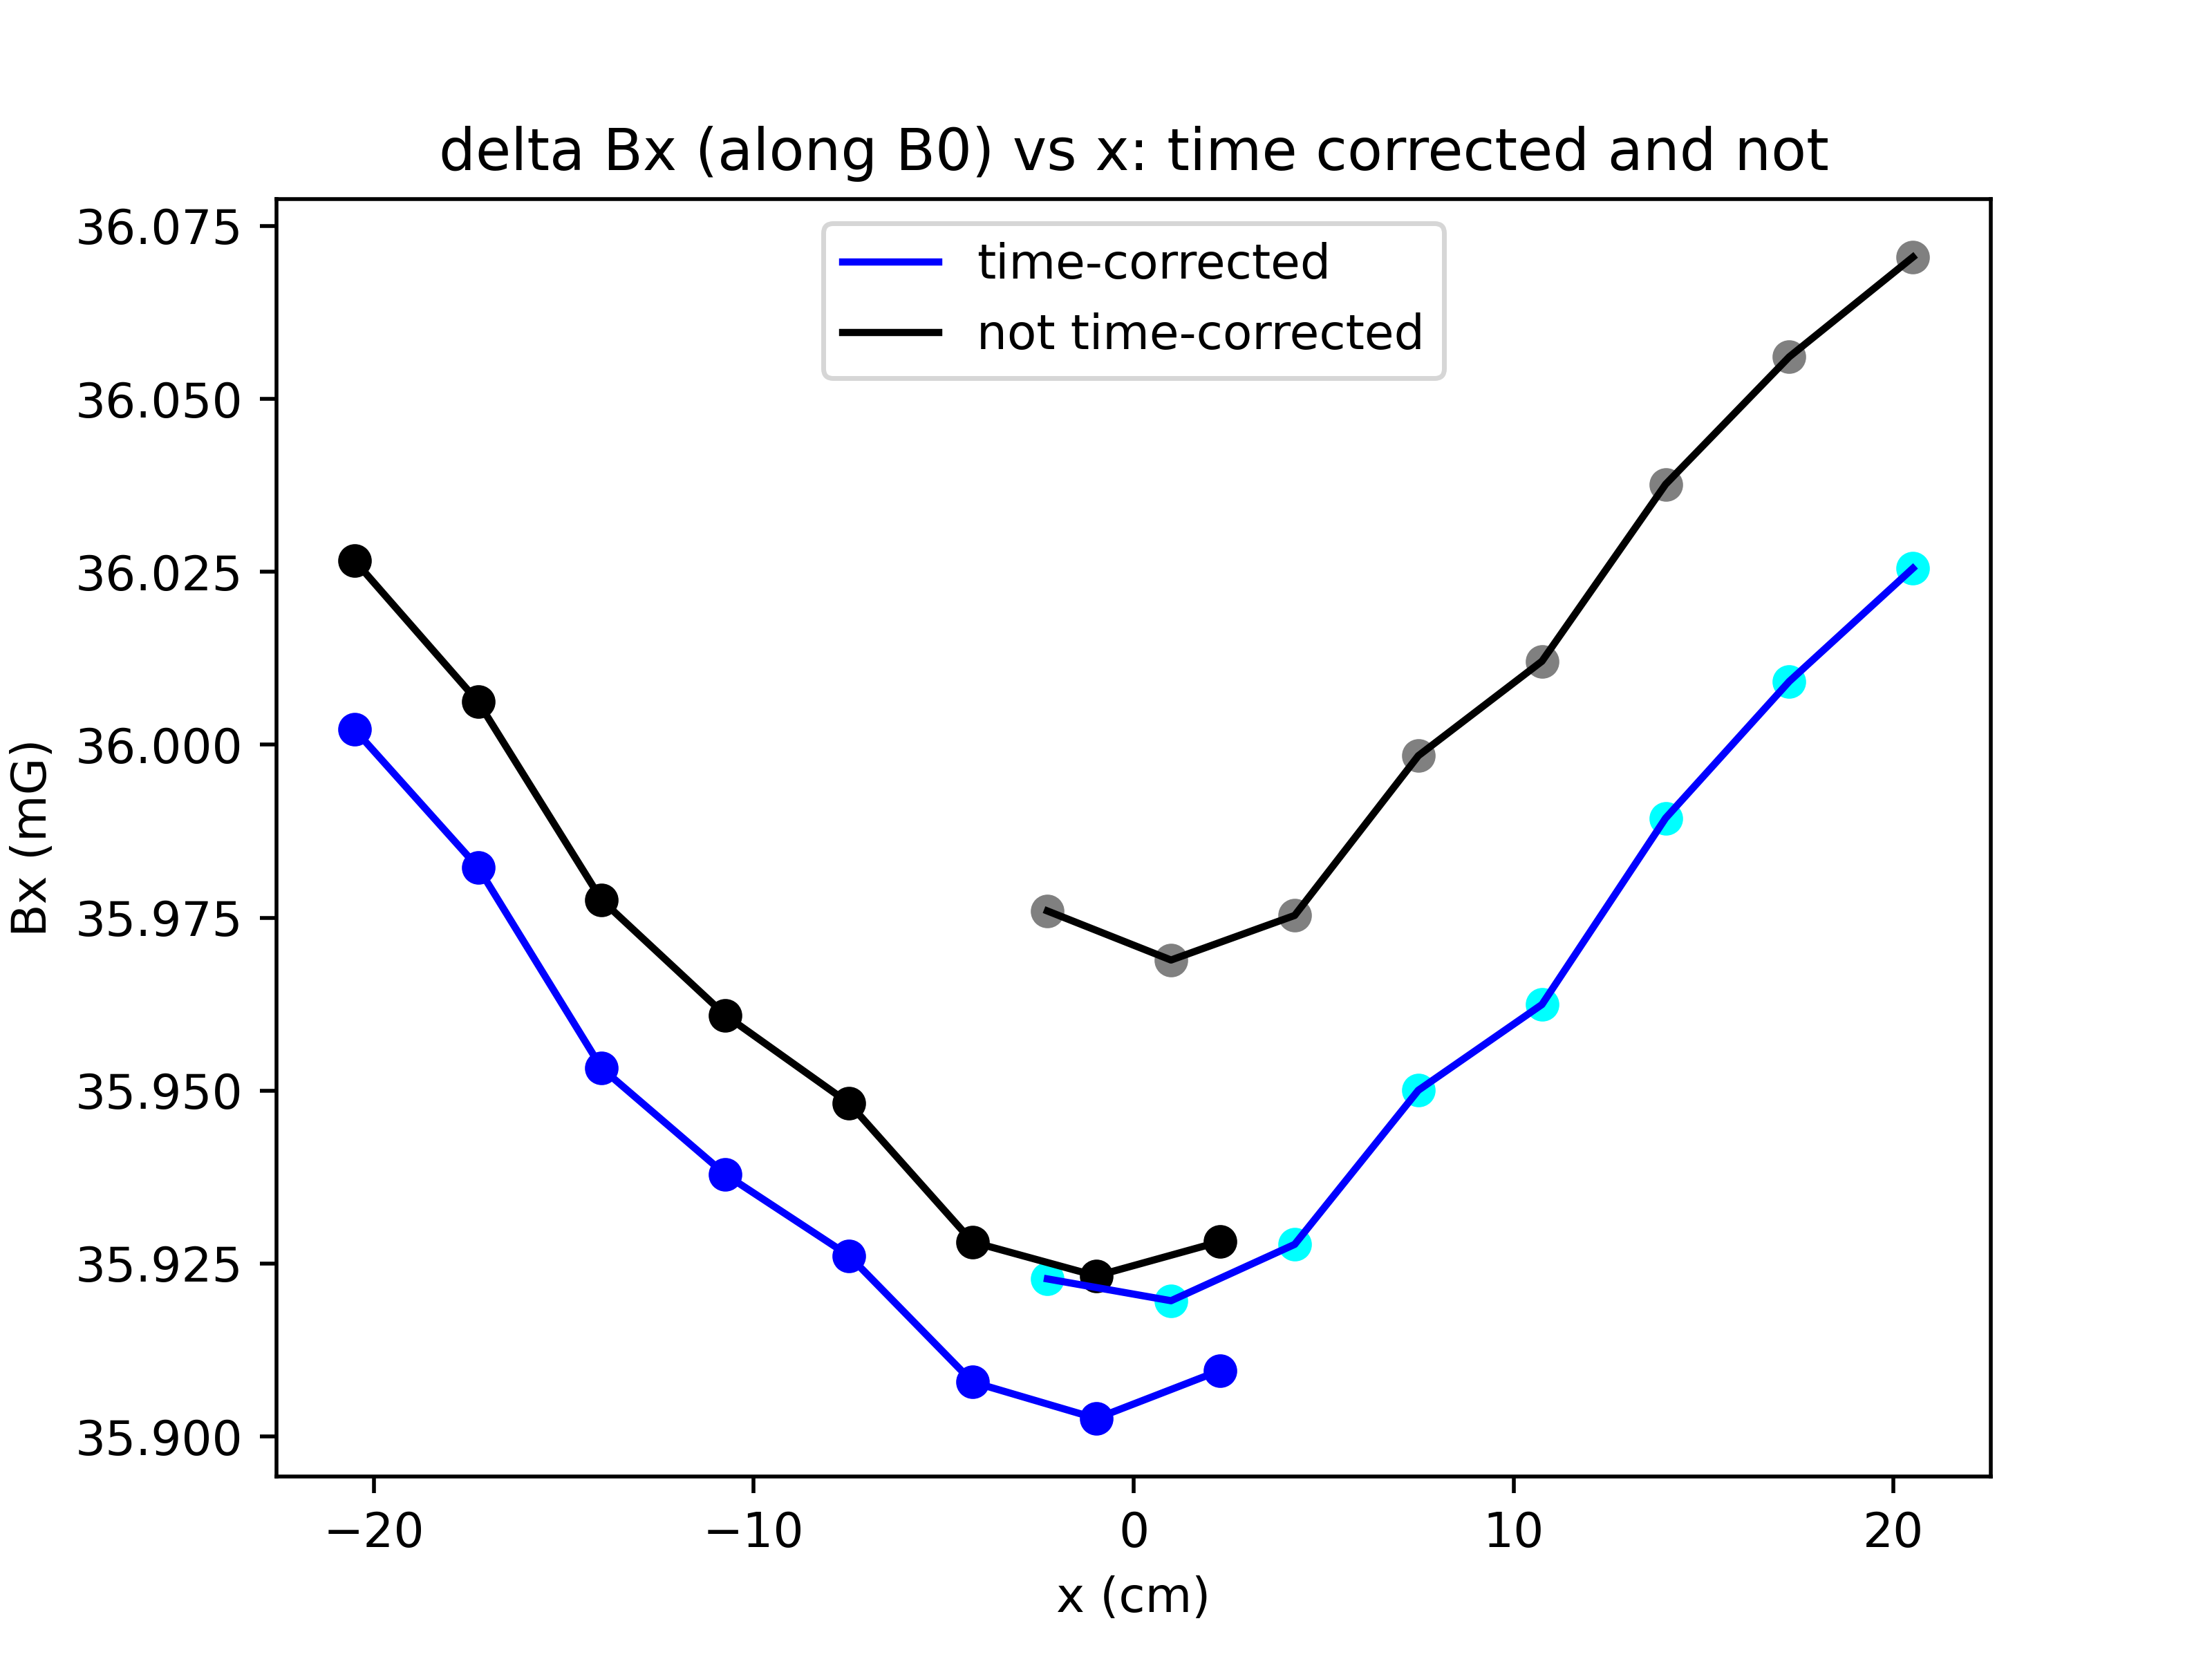
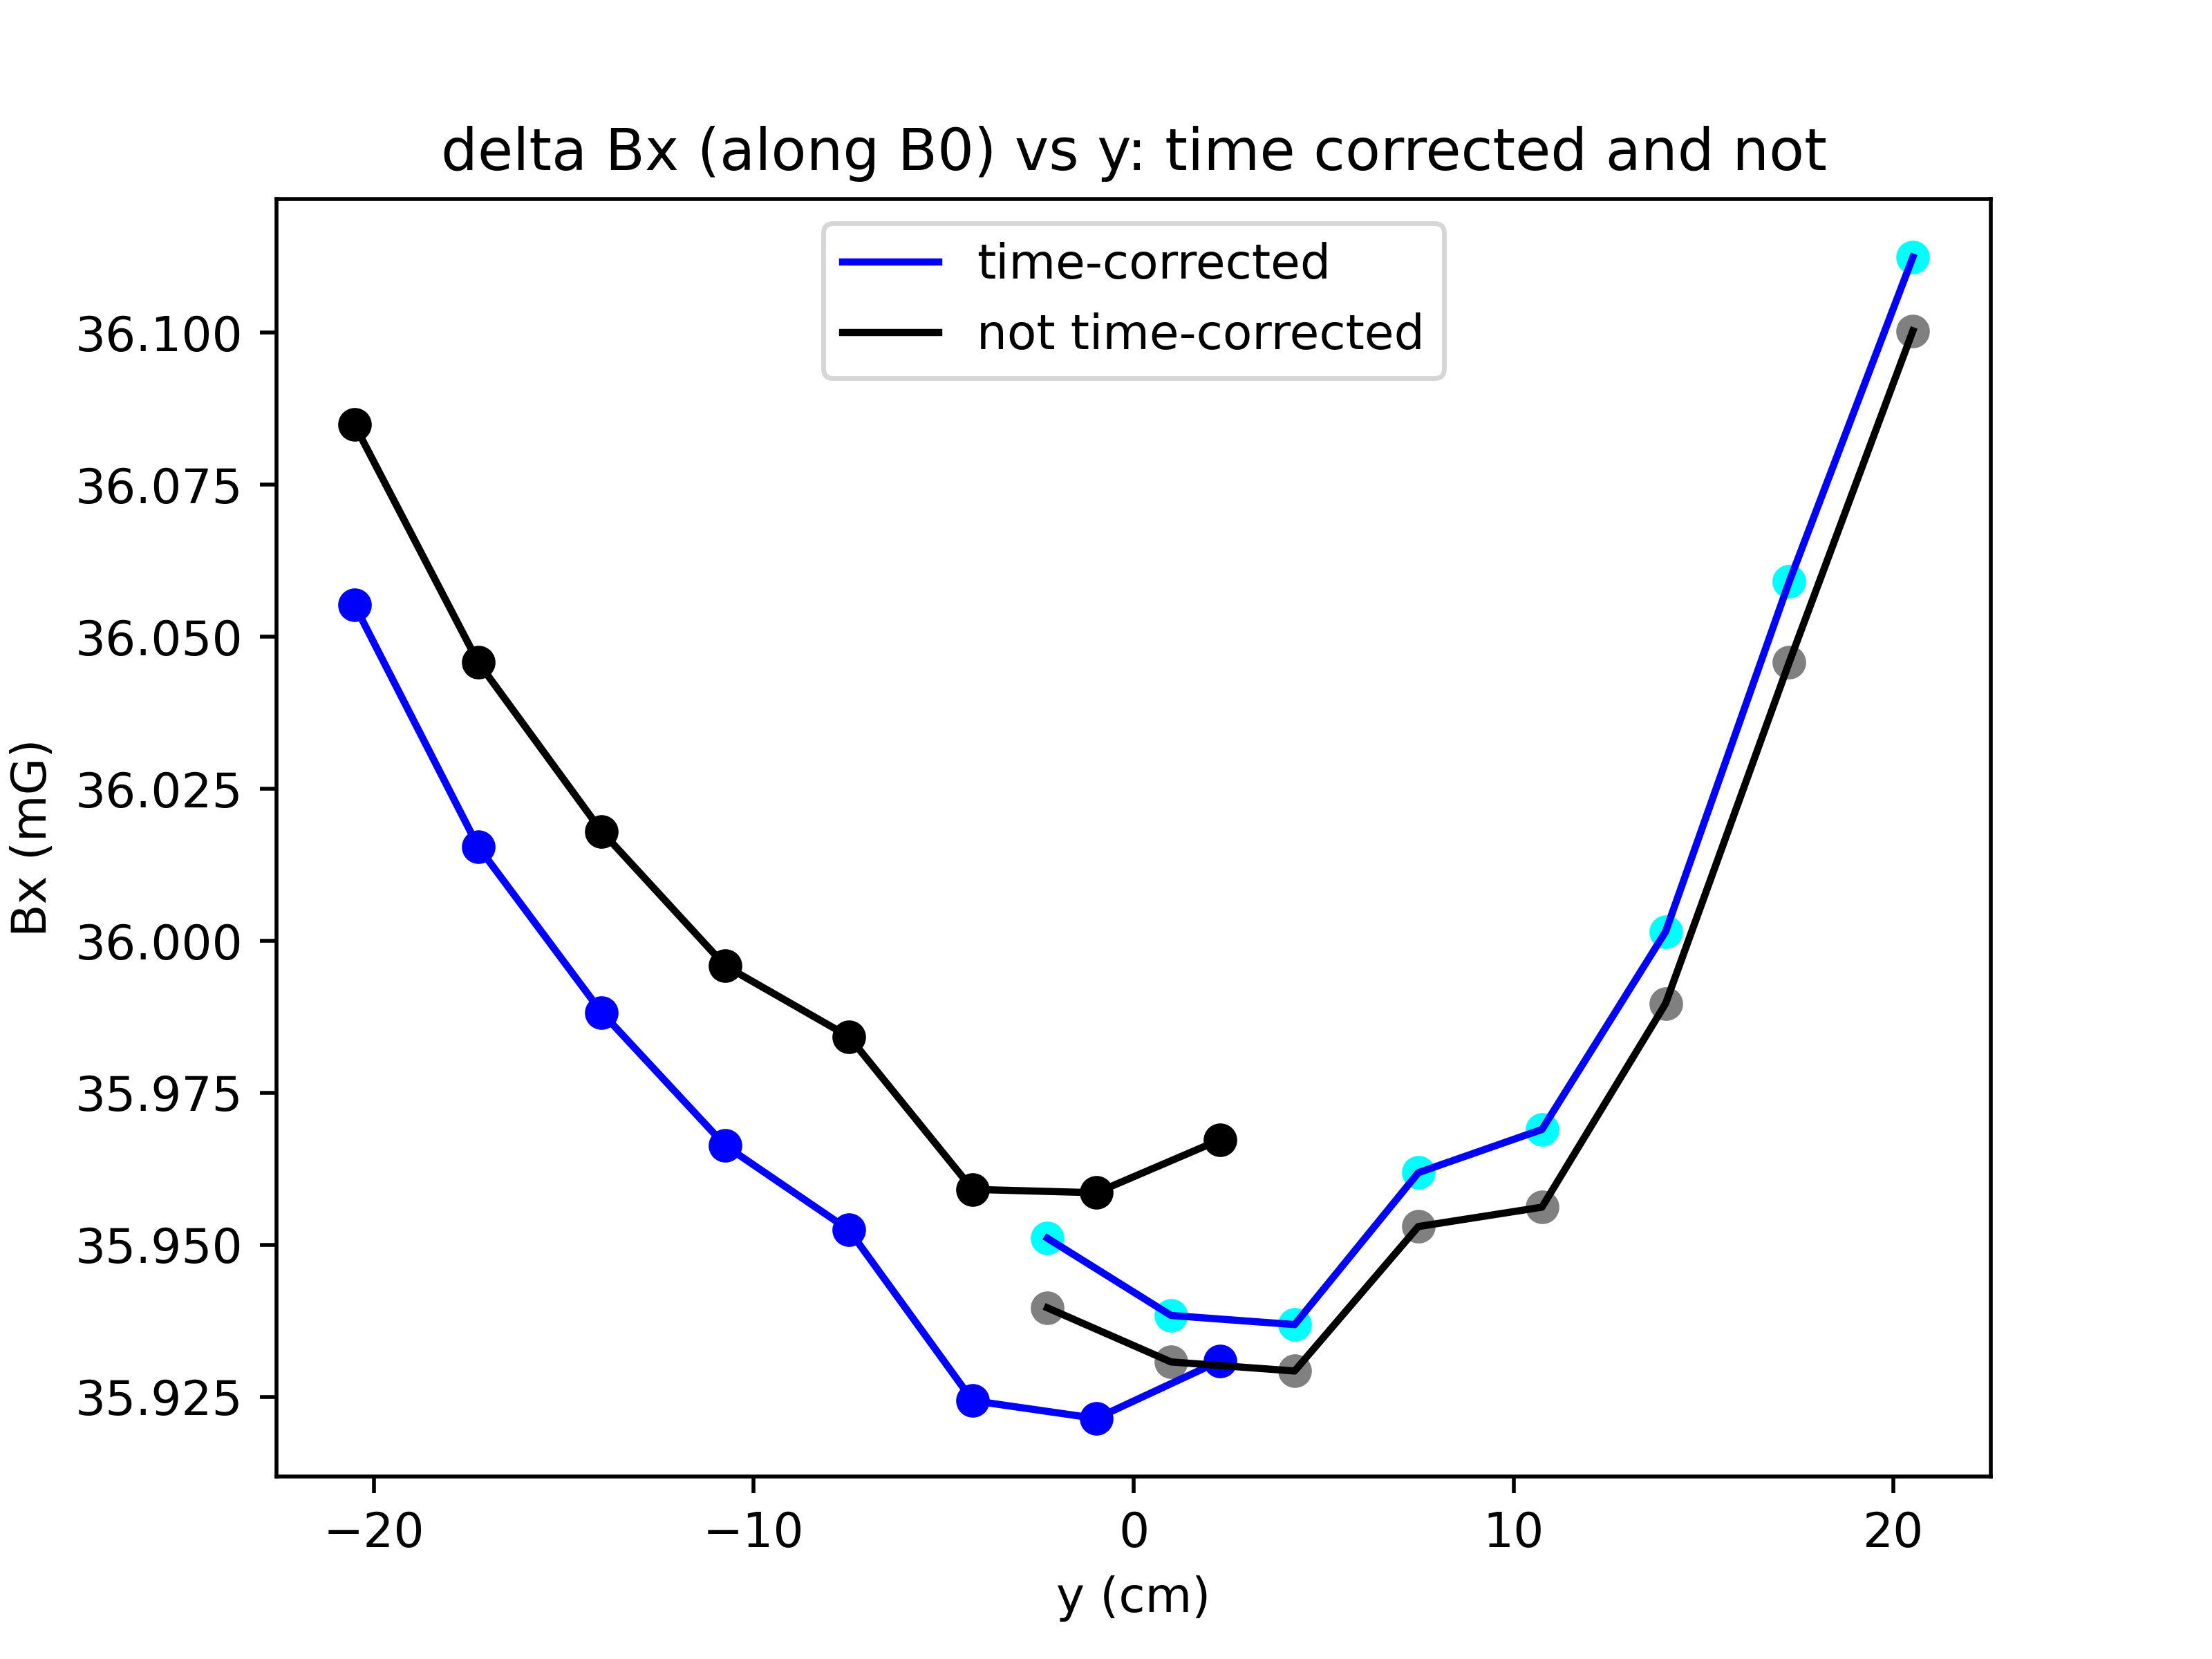
Compare time corrected data (60s interval) with non-time corrected data.
Plots show Bx vs. x and Bx vs. y.
Offsets shrink in both cases and points are clearly shifted.

Slide 10
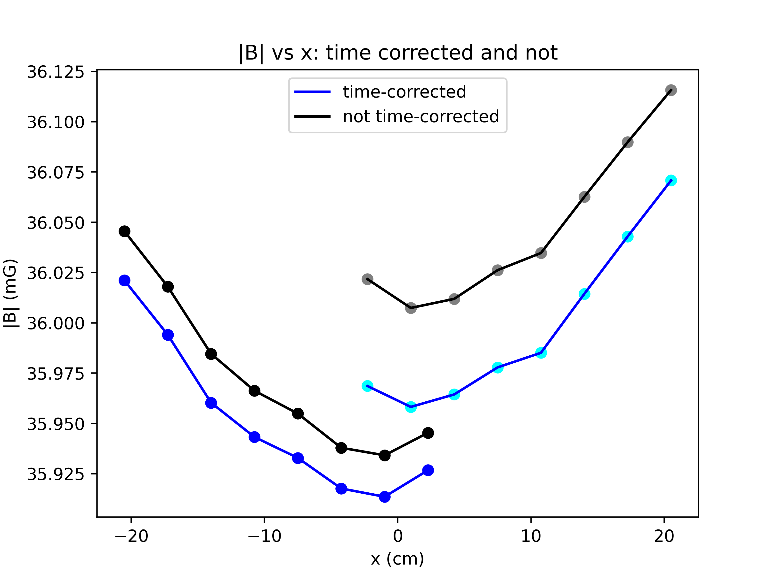
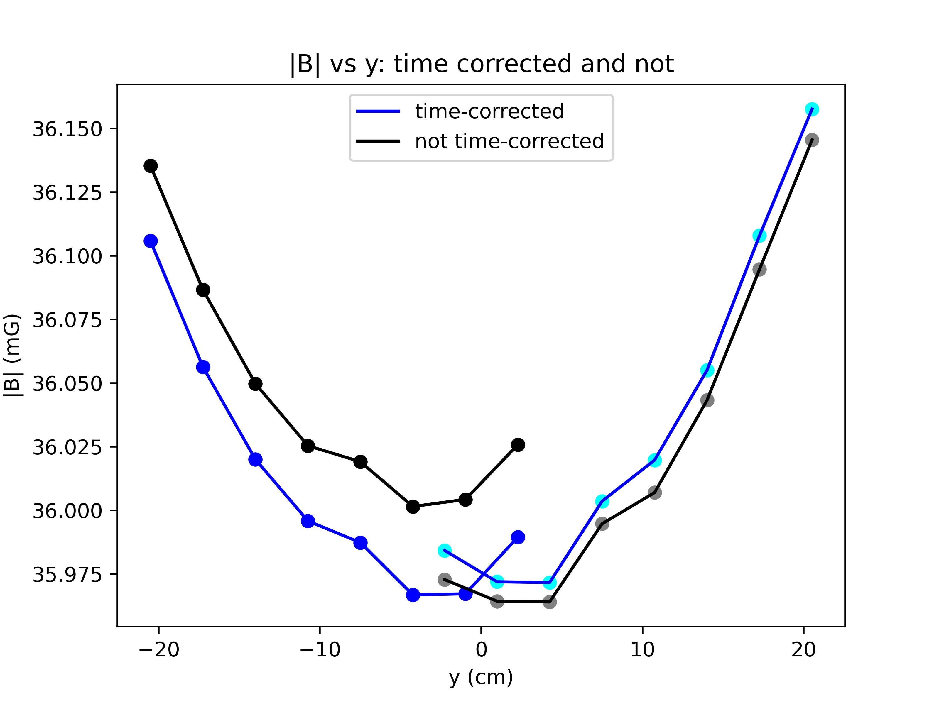
Compare time corrected data (60s interval) with non-time corrected data.
Plots show |B| vs. x and |B| vs. y. (I take differences of components first, then compute magnitude.)
Offsets shrink in both cases and points are clearly shifted. Remaining offset of ~0.05mG along x, ~0.005mG along y.

Slide 11
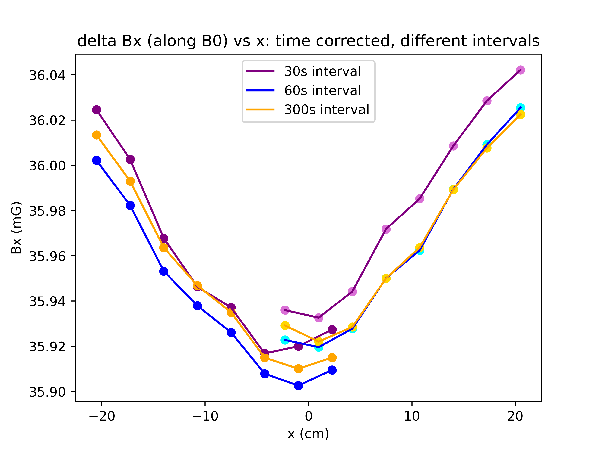
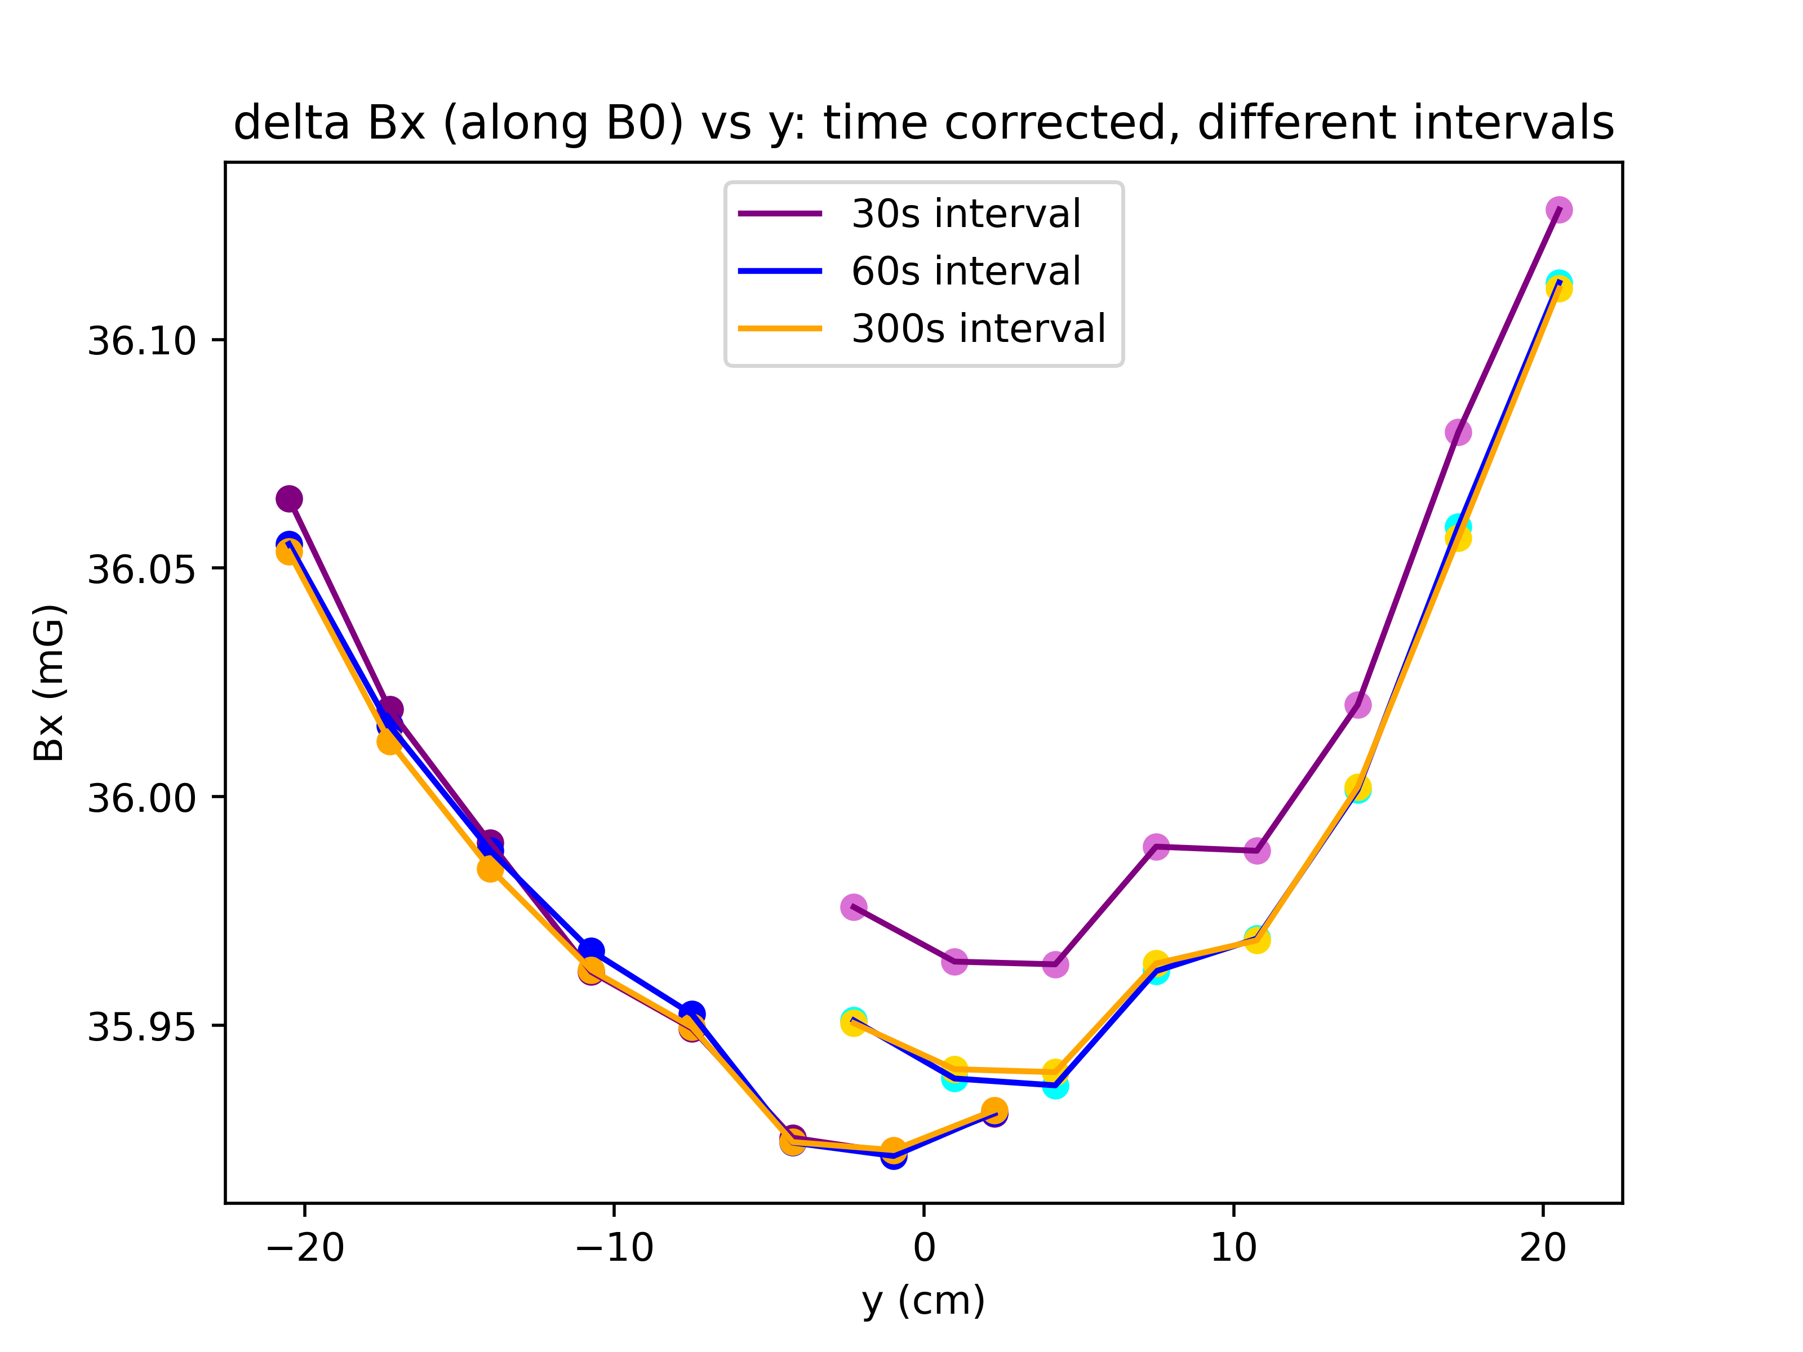
Effect of different interval sizes. 60s and 300s have best results

Slide 12
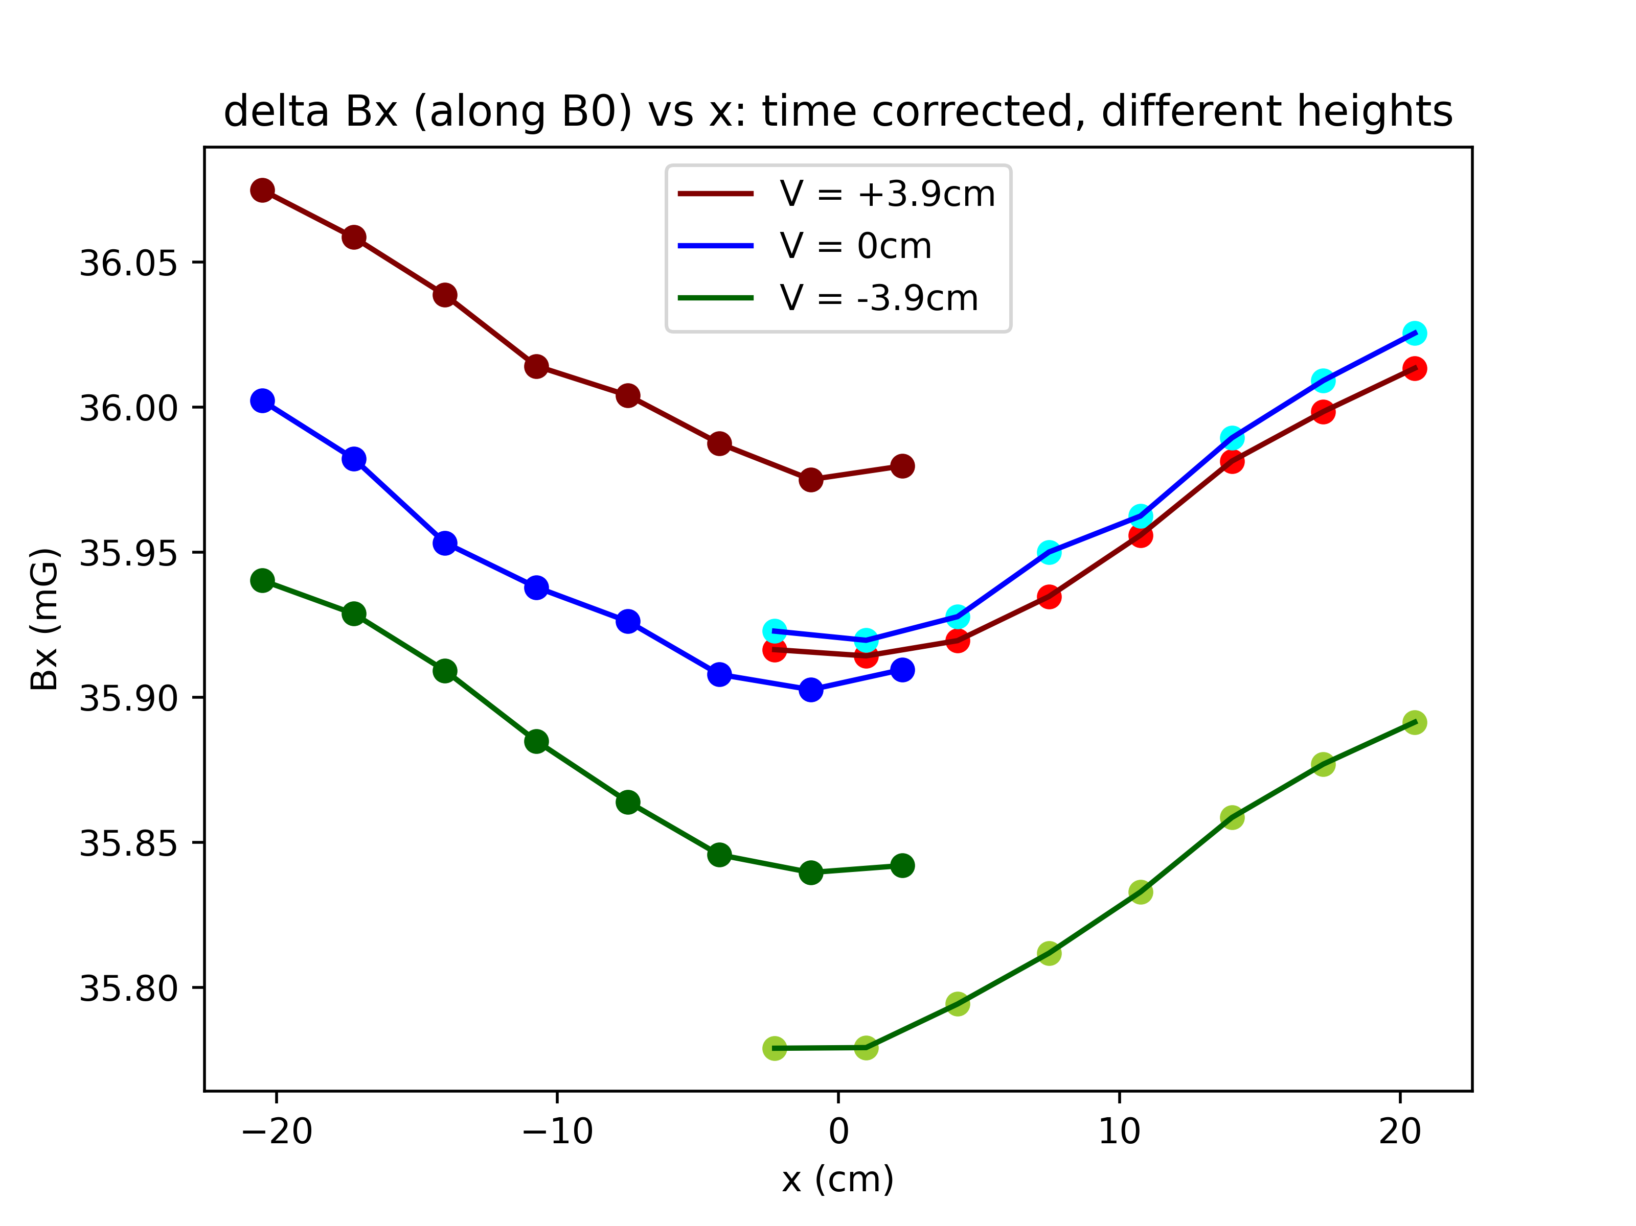

Time corrected Bx at different heights.
On Bx vs. x plot, the blue curves are still swapped relative to the red and green ones

Slide 13


Time corrected |B| at different heights.
On |B| vs. x plot, the blue curves are still swapped relative to the red and green ones

